Slide 1

Azure Benchmark TCO
Build a Strategic View of Your Azure Migration – Opportunities, Cost and Next Steps

Slide 2


Agenda
What You’ll Get
Approach
Tooling
Next Steps

Slide 3






Estate Analyses
Map your environment, uncover dependencies, and highlight modernization opportunities
Security insights
Spot gaps in patching, threats, and outdated software across your environment
What is the Azure
Benchmark TCO?
Migration Treatments
Get clear guidance on what to rehost, replatform or retire
This assessment gives you a data-driven view of your current estate and what migration to Azure would look like - costs, priorities, and practical next steps. It’s designed to help you move forward with confidence.
Wave Planning
Group migrations into manageable waves to reduce risk and improve clarity
TCO Modelling
Model Azure costs based on your real workloads and usage patterns

Slide 4

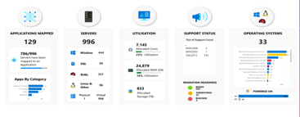


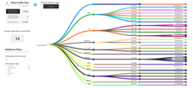
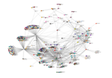

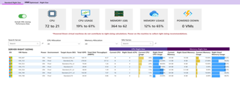
How it works
I
Simple, Secure and Fast
No setup required – runs from a jump box
No network changes or persistent credentials
Simple as RVTools, with richer VM and vCenter data
RUN
SCAN & UPLOAD
ACCESS INSIGHTS
Admin runs DMC one-time from a jump box – no setup, no saved credentials
Encrypted results are uploaded to Dr Migrate by the customer
Insights and dashboards instantly available for planning
Notes:
Dr Migrate Collector (DMC) works just like RVTools – a one-time, read-only snapshot run by your team.
There’s nothing to install, no footprint left behind, and no saved passwords.
You control the run, and you review everything before any data leaves your environment.
It’s quick – we could be on a call today and have insights in your hands tomorrow: estate visibility, cost modeling, and modernization opportunities.
All that’s needed is a user with access to VMware and guest credentials.
We’ll walk you through it live, make sure you're comfortable – then you’re off and running.

Slide 5
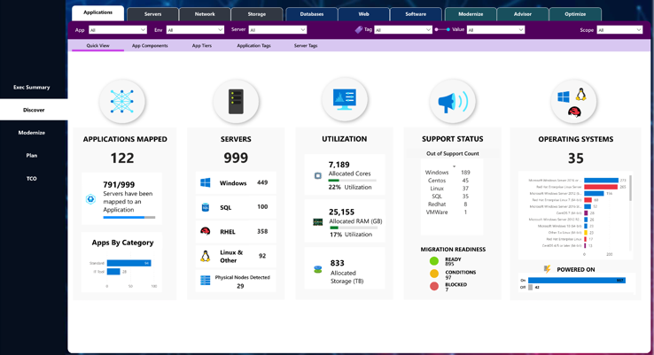
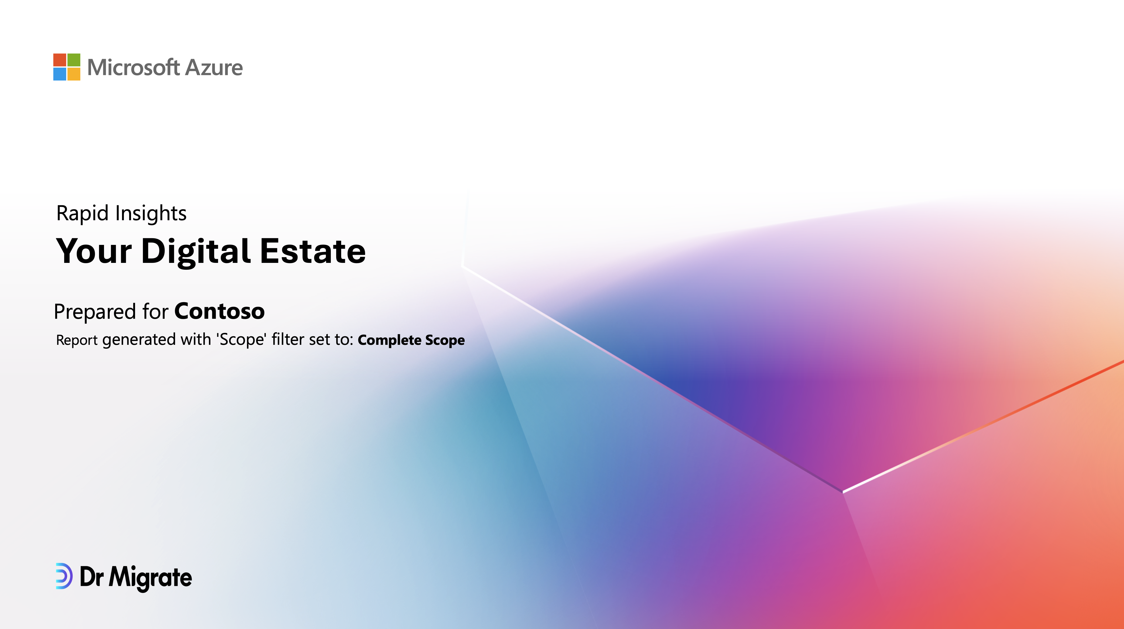
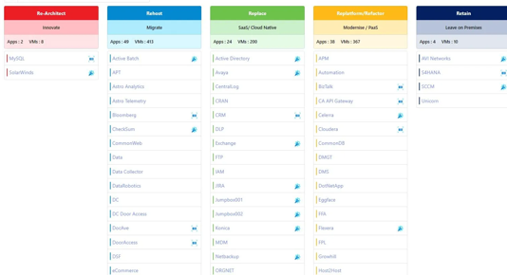
What you’ll get from Azure Benchmark TCO
Insight-Driven Dashboards
Explore 100+ dashboards covering infrastructure, cost, sizing, and readiness — all built from your actual environment.
Executive Reports
Get concise reports with guidance on cost, risk, modernization, and migration timelines.
AI-Assisted Planning
Leverage AI-powered tools that help map treatments, structure wave plans, and simplify strategy.

Slide 6
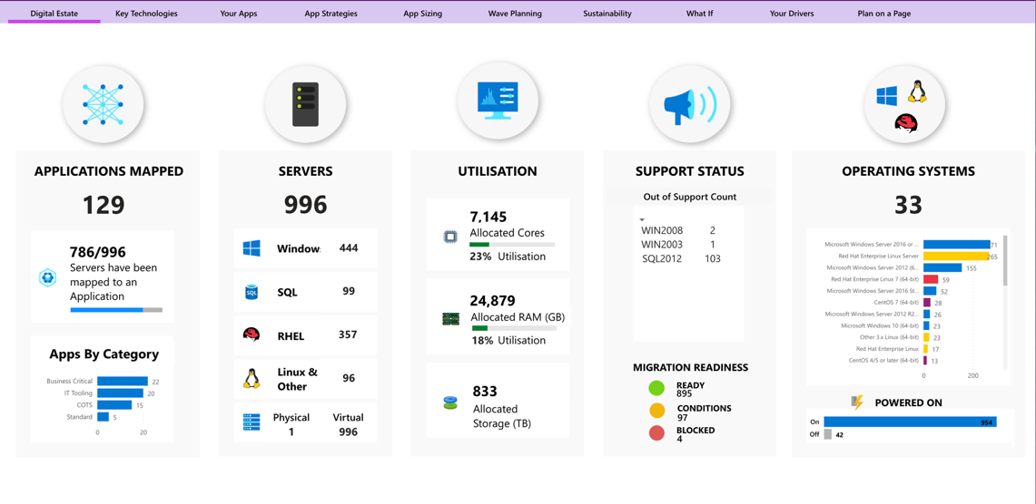
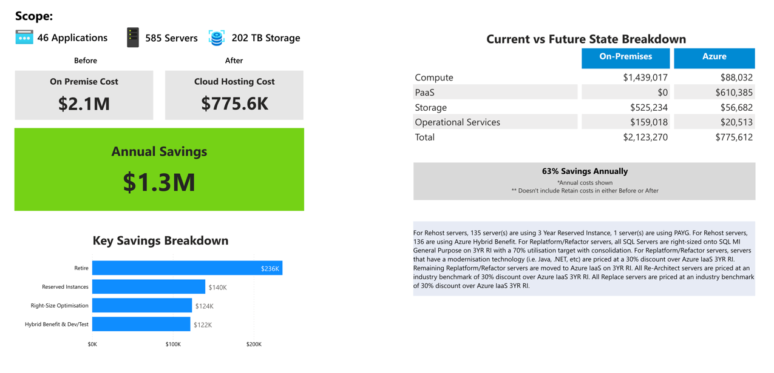
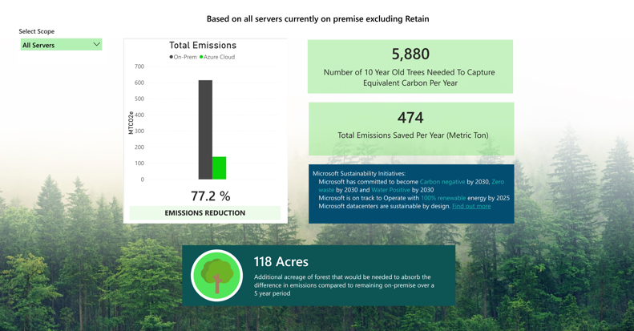


Technical Assessment
Sneak Peak: What You’ll See
Complete Overview of your Digital Estate
Estate Overview
✅ Interactive drill-down dashboards: Navigate areas of interest across your estate with dynamic, clickable insights
✅ Migration readiness at a glance:
Instantly spot which apps are ready, blocked, or conditional
✅ Support risk flagged:
Identify out-of-support OS and aging workloads
✅ Optimisation insights:
Get recommendations for right-sizing, Azure-native replacements, and PaaS migration paths

Slide 7
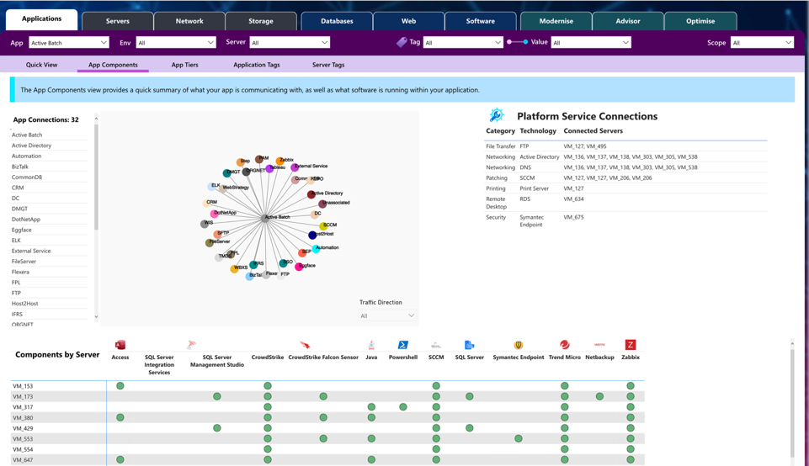
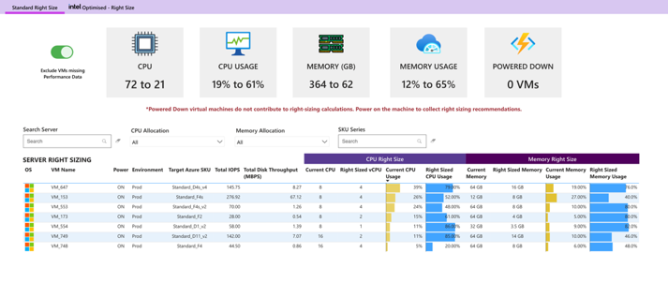
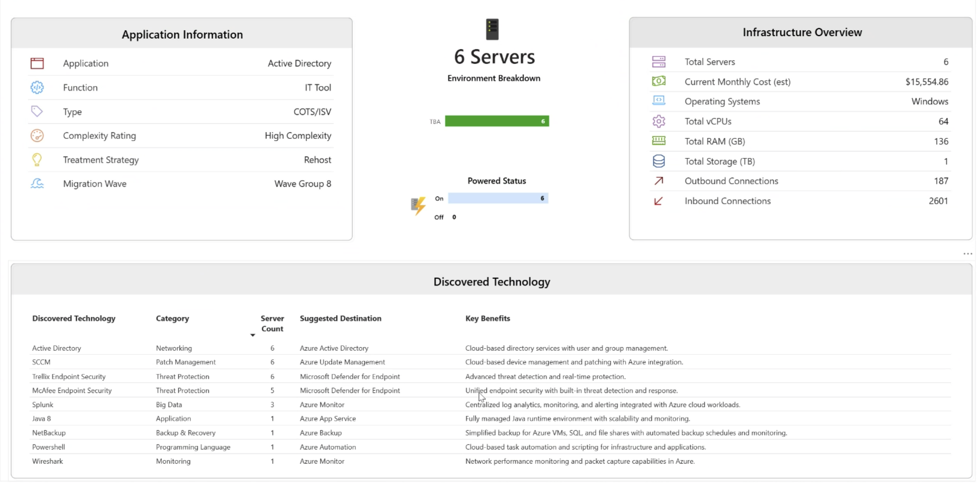
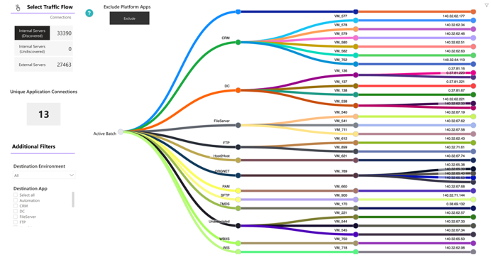
Technical Assessment
Sneak Peak
Application-Level Insights
App Insights
Single-click access to app context
Browse everything about an app in one place: its infrastructure, software, dependencies, modernization fit, usage, and risks.
Deep app-to-infrastructure mapping
See the full stack servers, databases, OS, and services powering each app to uncover hidden dependencies and blockers.
Architecture and dependency visibility
Trace app-to-app and app-to-platform flows across runtime, data, network, and security layers.

Slide 8

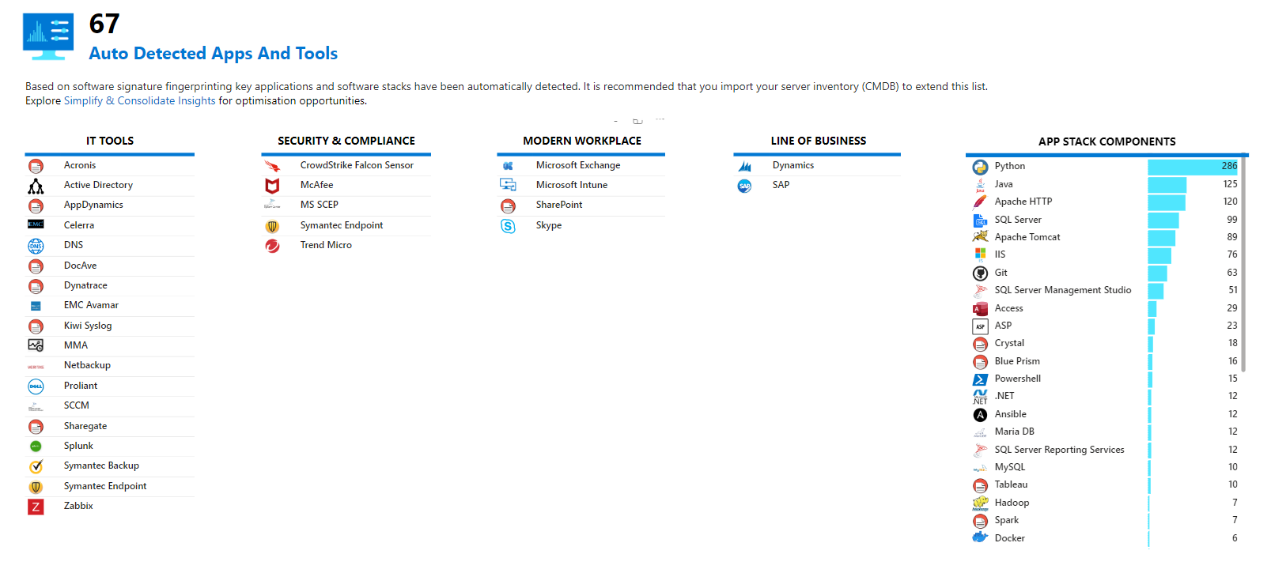
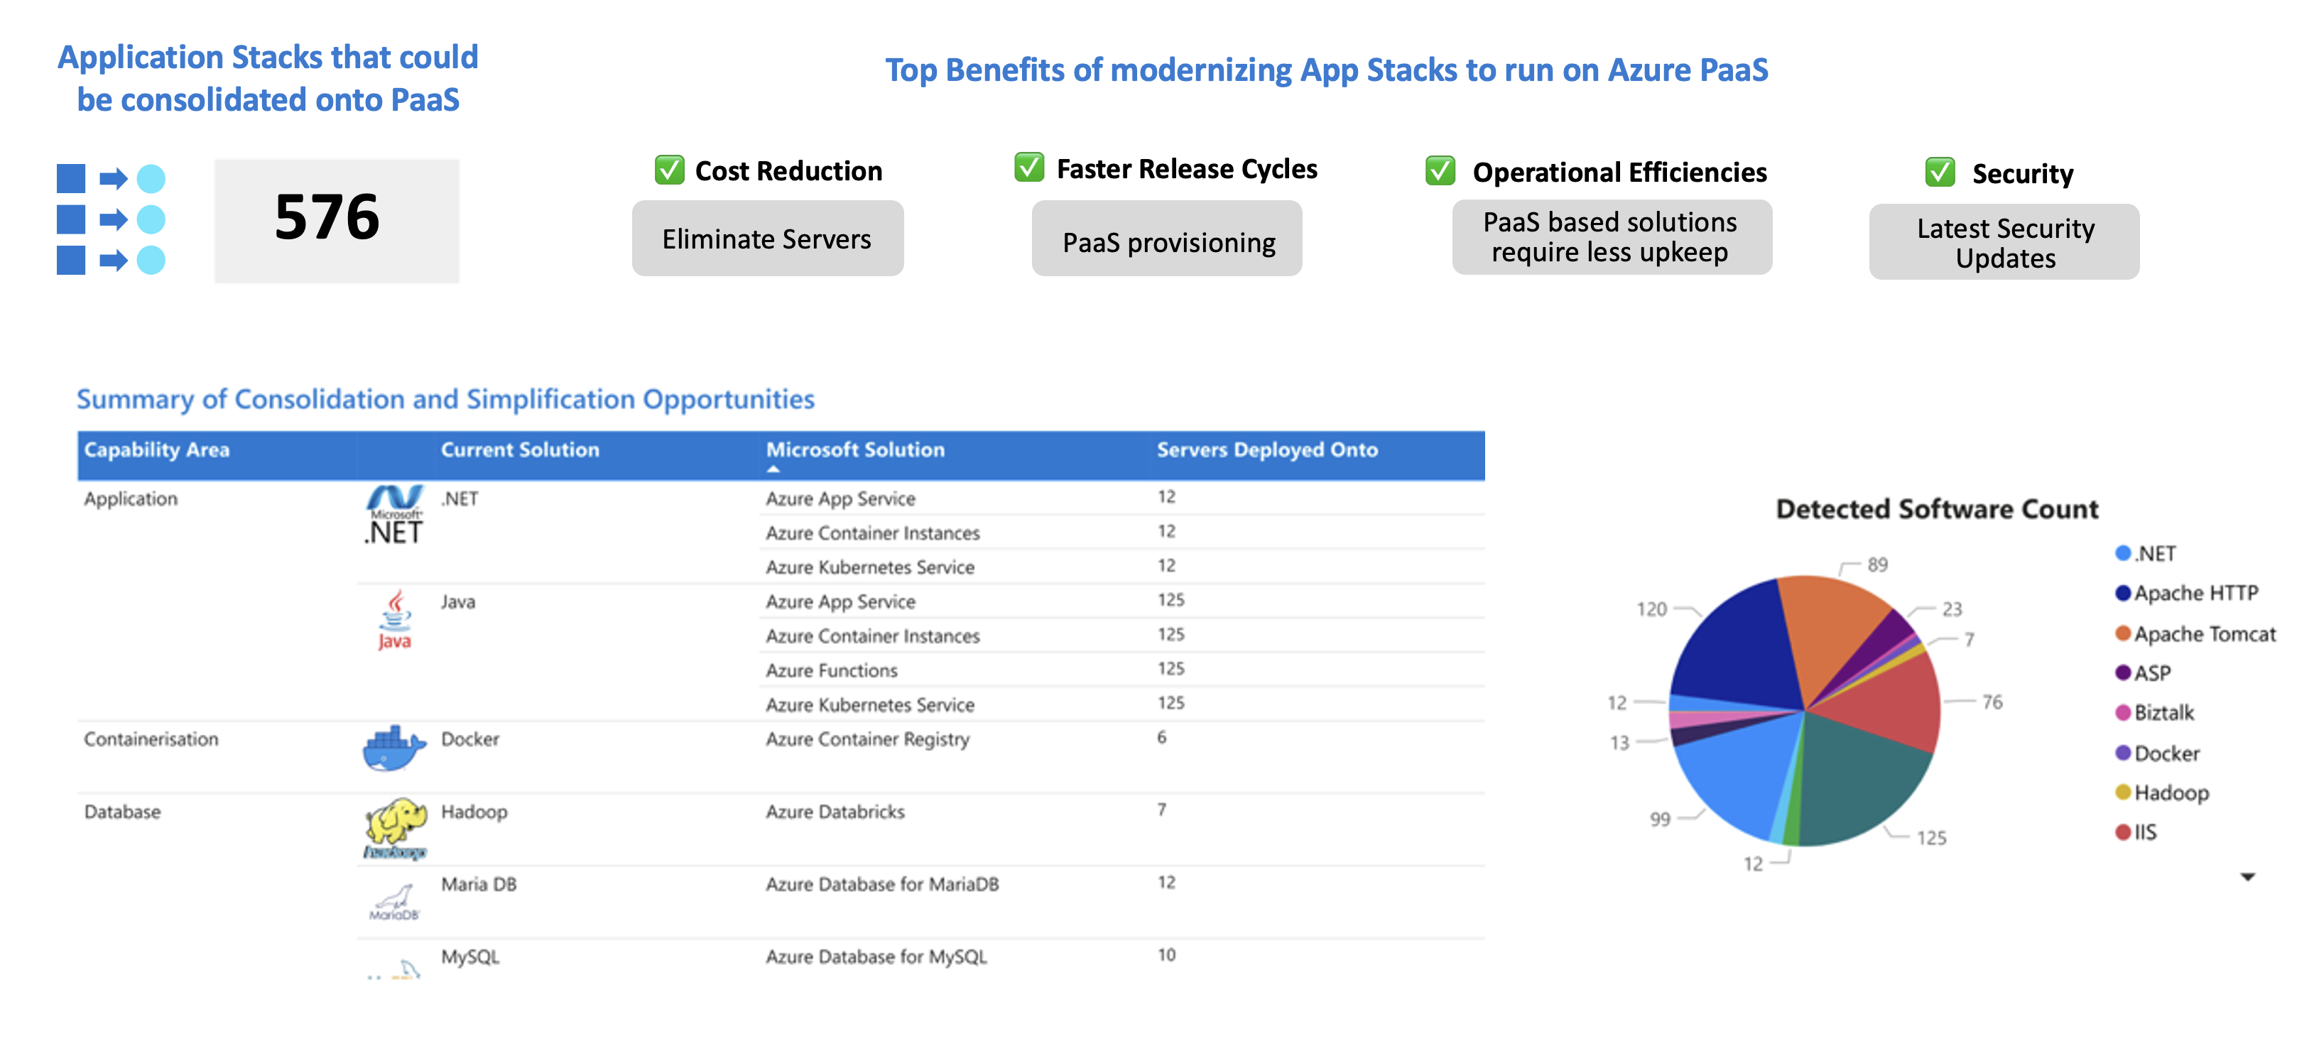
Technical Assessment
Sneak Peak
Modernization and 6R Planning
Modernization
✅ Automated 6R strategy assignment
Quickly categorize workloads across Rehost, Refactor, Re-architect, Replace, Retain, and Retire, accelerating planning and alignment.
✅ PaaS fit and modernization insights
Uncover high-fit candidates for Azure App Services, SQL MI, Functions, and other platform services based on actual stack components.
✅ Automated 6R strategy assignment
Quickly categorize workloads across Rehost, Refactor, Re-architect, Replace, Retain, and Retire, accelerating planning and alignment.

Slide 9
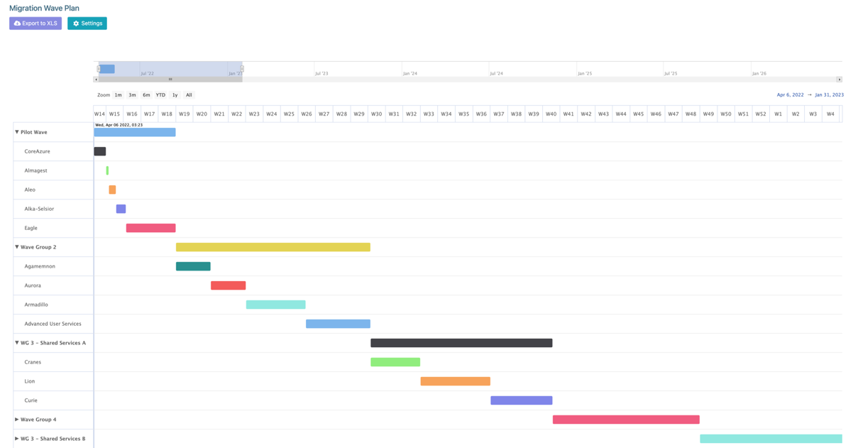
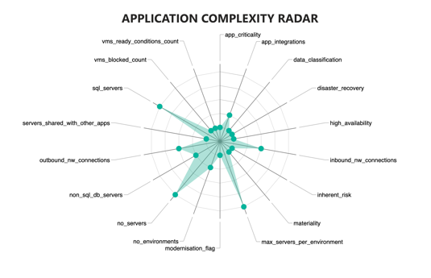
Technical Assessment
Sneak Peak
Wave Planning & App Complexity Sizing
Wave Planning
Auto-generated wave plan based on network topology and business unit alignment
✅ Flexible sequencing by application owner, data centre, software lifecycle, or complexity
✅ Customizable waves to align with business priorities and migration timelines
✅ Effort & complexity scoring – Prioritizes low-risk apps first, improving velocity and partner delivery confidence

Slide 10
Technical Assessment
Sneak Peak
Total Cost of Ownership
Financial Planning
✅ TCO, cloud cost modelling, and right-sizing insights to drive financially sound decisions
✅ Sustainability metrics and energy impact analysis to support ESG goals and green IT initiatives

Slide 11
Approach & Tooling

Slide 12





Customer Delivery Flow
01.
Kick-Off
& Scan
Kick-Off
1 Hour
Data Collection
1 Hour
Assessment Overview
Expectations & Tooling
Share Letter of Engagement
Next steps email and links
Email sent to confirm access for data collection is ready
Scan target environments
Upload Results
Remediate if necessary
02.
Planning
Customer Not Required
Workshop Prep
Validate uploaded scan data
Prepare Dr Migrate for planning
Import CMDB data if available
Customer shares CMDB data
if available
1 Hour
Workshop 1
Post-Scan Planning
Review Early Insights
View Advanced Dashboard
Refine CMDB mapping
Capture migration goals
Set modernization targets
Capture App Strategies
Workshop 2
Workload Planning
1 Hour
03.
Delivery
Present Plan
& Next Steps
1 Hour
Refine 6R Treatments
Refine Wave Plan
Run App Sizing
Review overall strategy
Discuss recommended next steps
Notes:
01. Kick-Off & Scan
The journey starts with a brief Kick-Off session to align on expectations, tooling, and outcomes. Roles are confirmed, the LOE is signed, and next steps are shared via email.
Before the scan call, it's essential to verify that customer admins have the correct credentials to avoid access issues.
Data collection takes around an hour and involves running the selected scan tool (such as Dr Migrate or Azure Migrate), uploading the results, and remediating any data quality issues if necessary.
02. Planning
Internal step to validate uploaded scan data, set up Dr Migrate for planning, and import CMDB data if available.
The first planning workshop focuses on reviewing early insights, confirming modernization goals, and refining the inventory. CMDB mapping is updated as needed.
The second workshop uses that data to assign application strategies, refine 6R treatment plans, and build a wave plan.
03. Delivery
The final delivery step presents the consolidated strategy, treatments, and wave plan. The team validates the plan with stakeholders and outlines clear next steps, whether for execution or further integration.

Slide 13



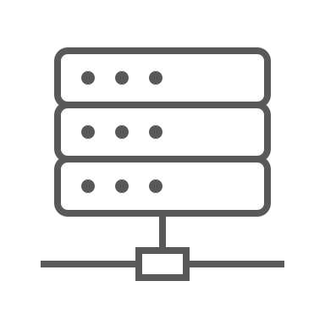


How Data Collection with DMC Works
No Agents. No Installs. No Persistent Access.
On-Premises
Secure SaaS Instance
Target servers
Dr Migrate
DMC executes read-only queries using vCenter API
Data is only uploaded when triggered by the customer
Port 443 (HTTPS)
Port 443 (HTTPS)
Windows
Jumpbox
A dedicated, isolated SaaS instance provisioned exclusively for the customer
Scan Targets
vCenter Server version 6.0 and above
All attached Windows & Linux VM’s
Connectivity:
No external network comms
Port 443 used from Jumpbox to vCenter
Output:
Metrics are saved locally as an encrypted ZIP
ZIP contents are fully reviewable before upload
Non PII data only
Credentials:
Customer Admin one-time-run
No persistent credentials
PW stored in memory only
vCenter Server read-only account
Guest admin (Win/Linux)
Metric Collection:
Read-only queries sent via vCentre API
Lightweight: ~5MB, ~60 sec, ~2% CPU per VM
DMC pre-checks for high CPU & memory
~1,000 VM scanned in under an hour
Customer SaaS Instance
All customer data is air-gapped hosted on dedicated infrastructure
Access controlled by SSO
Notes:
How DMC Collects Data – At a Glance
1. No agents, installs, or persistent access
DMC runs from a Windows jumpbox and connects securely to vCenter using read-only API calls.
2. Secure and lightweight
Connects via Port 443 (HTTPS)
No external network access needed
Scans ~1,000 VMs in under an hour with minimal resource usage
3. You stay in control
Nothing is uploaded automatically
Data is stored locally first
Upload happens only when you trigger it
4. What’s collected?
VM config and usage stats (no PII)
Stored as an encrypted ZIP, fully reviewable before upload
5. Where does the data go?
To your dedicated, isolated Dr Migrate SaaS instance
Hosted separately, air-gapped, and secured by SSO

Slide 14
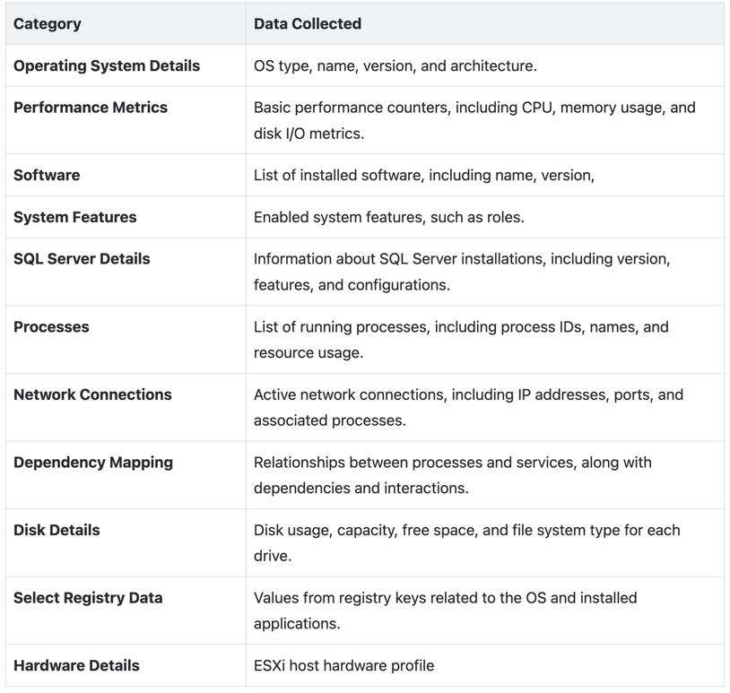
What is Collected
Metrics Collected
No PII, sensitive data or deep inspection.
DMC is purpose-built to collect only environment-level metadata required for effective cloud planning. User data, application content, or business-sensitive information is never accessed or collected.
Full Transparency
Metric Visibility Customers can fully review all collected data, including test runs on a subset of servers, to ensure nothing unexpected is captured.
No automatic transmission of data DMC does not send any data. Output is locally available for review before customers initiate their own upload.

Slide 15


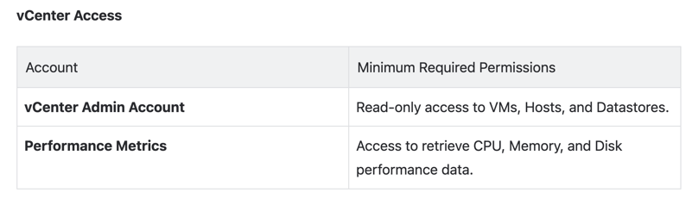
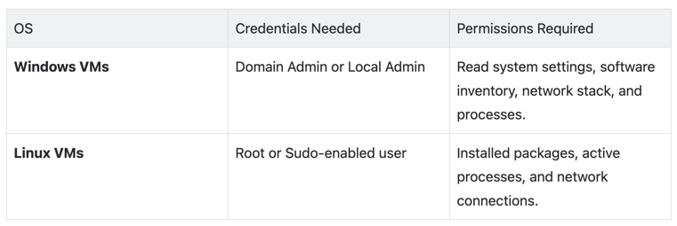
Required Credentials
DMC is executed by a customer admin as a one-time activity
Temporary admin credentials are used to access vCenter and guest VMs.
Credentials are only stored in memory, nothing is saved.
vCenter Access
Guest OS Credentials
To ensure DMC can perform discovery at the hypervisor level the following permissions are required.
To ensure DMC can perform discovery at the guest VM level the following permissions are required.

Slide 16

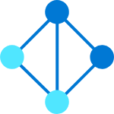
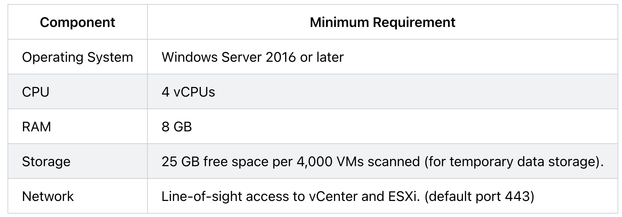
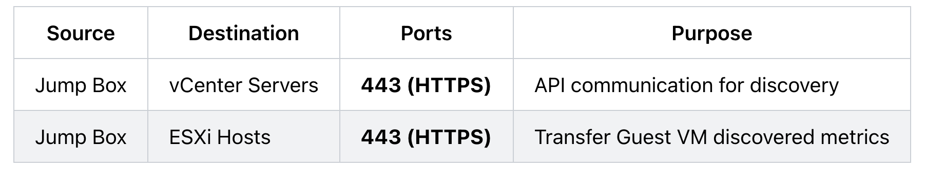
Jumpbox Requirements
DMC runs from any Windows jumpbox within the customer’s network, provided it has line of site to vCentre.
This system must meet the following specifications:
Jumpbox Requirements
Network Requirements

Slide 17

FAQ
Question | Answer
Where can I find more information about DMC | Visit learn.drmigrate.com – the official hub for DMC guides, support, and FAQs.
Can I scan more than 1 data centre | Absolutely. Scan multiple data centres simultaneously or one at a time – your choice. Upload each set when ready.
Can Dr Migrate help with my migration | Yes. Connect Azure Migrate to Dr Migrate to unlock live insights. Visualize network flows, SQL modernization needs, and more in real-time dashboards.
After the 90 days can I still access Dr Migrate | You’ll enter hibernate mode automatically – no data loss. You can re-enable full access or decommission anytime.
Does DMC need network access to the VMs? | No. Only needs access to vCenter and ESXi hosts, not the individual VMs.
What’s installed? | Nothing. DMC runs agentless from a jumpbox – no installs, no agents, no config changes.
Is this secure? | Yes. It uses read-only API calls, no credentials are stored, and all actions are logged, no data is automatically transmitted externally. You can inspect what’s collected before upload.
Can we control when it runs? | 100%. You control the run. We guide you in real time, but nothing happens without your lead.

Slide 18
Next Steps

Slide 19
Next Steps
We’ll share the Kick-Off deck and tooling links
Let’s schedule a one-hour scan session
Within 48 hours of completing the scan, we’ll be ready to walk you through your environment
If you have a CMDB, in any shape, share it so we can improve planning accuracy
Ready to Scan Checklist
Make sure these are ready before your scan session
An admin with vCenter Admin credentials is present
An admin with Guest Admin Credentials for Windows and Linux is present
Ensure Jumpbox has network line of sight to vCentre and ESXi hosts
Ensure Jumpbox can resolve ESXi host via DNS

Slide 20
Thank You

