Slide 1
2359BC02-6838-4D94-8CAC-4C1A9F4A54D8
Migration Plan
Prepared for: Contoso
Complete Scope

Slide 2
1504FF82-CD05-4256-8D72-BA7626A85901
WHAT'S COVERED
Migration Plan - From Assessment to Execution
End-to-end migration plan: estate insights, strategy decisions, and delivery roadmap
DISCOVERY
STRATEGY
EXECUTION
Discovery & Scope
Migration Decisions
Execution & Delivery
Executive Overview
6R Strategy Allocation
App Complexity Profile
Environment Profile
Cloud Targets
Wave Plan Overview
Cost Overview
Risk Management
Next Steps
Appendix
Note: Each page includes a navigation breadcrumbs showing where to access live insights in Dr Migrate.
Migration Planning
Migration Treatment
>
>

Slide 3
CFF6A9FC-F8B8-43BC-8137-7899F8671051
EXECUTIVE OVERVIEW
Migration Plan Overview
Assessment complete - environment profiled, treatments assigned, cost model validated, initial wave plans defined.

Slide 4
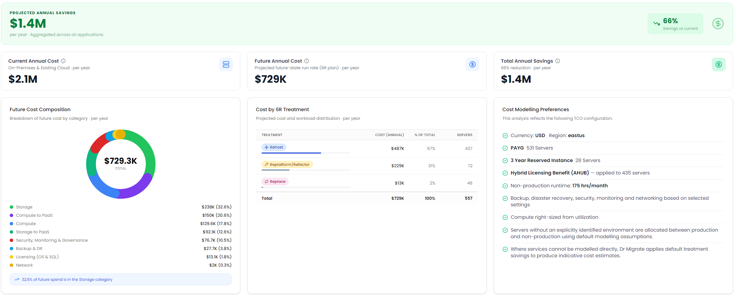
9A02A9F0-3090-4EA7-8513-BDC0C47DEC7A
FINANCIALS
Cost Overview & Savings Drivers
Total cost of ownership analysis with savings broken down by driver - rightsizing, modernization, and licensing optimization.

Slide 5
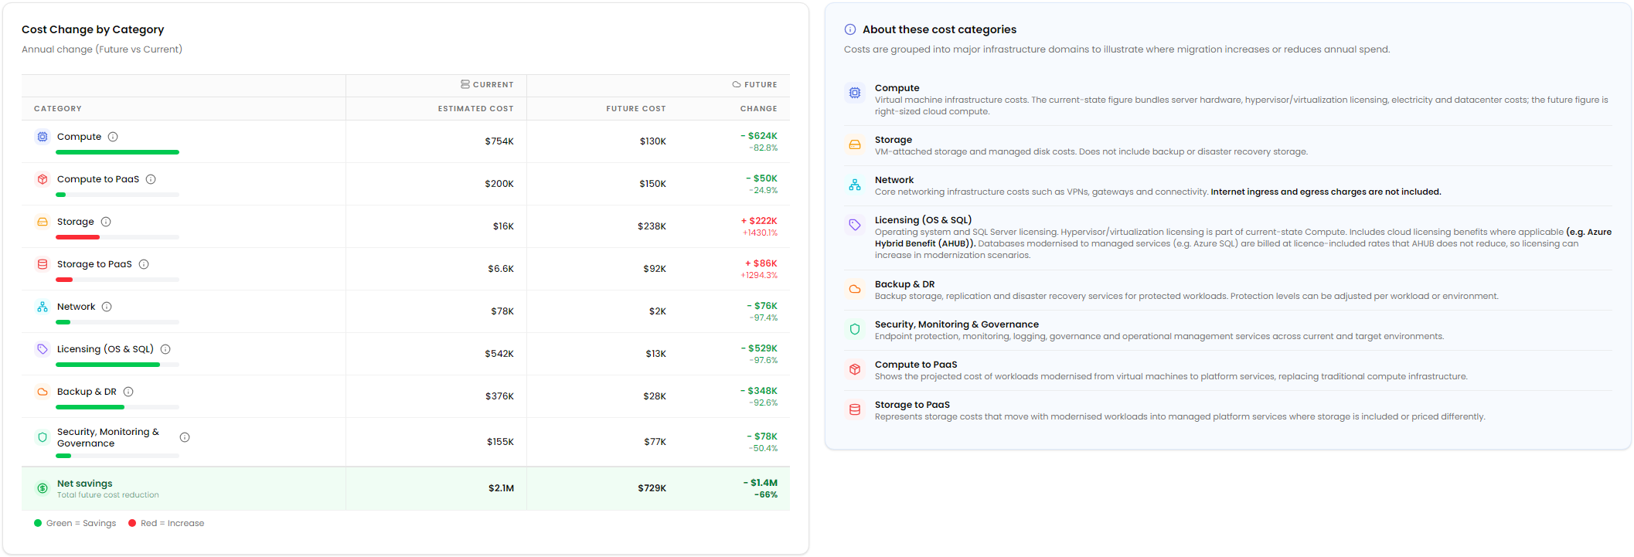
BA7B1DCC-572A-4036-A711-C4E8E7CA963F
FINANCIALS
Cost Comparisons - by Service Tiers
A line-by-line comparison of current and future-state annual cost across each infrastructure domain, showing where migration reduces spend and where it adds.

Slide 6

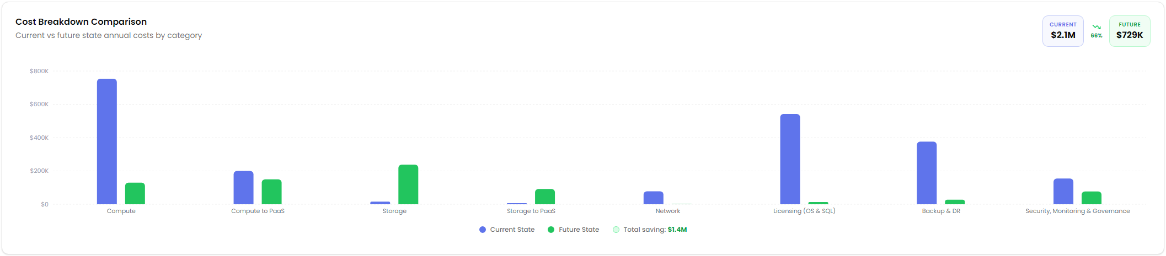
2B846F6B-DE05-4B54-AB0C-6BBB23939D79
FINANCIALS
Cost Comparisons - Visualized
Side-by-side comparison of current vs future state cost by category.

Slide 7

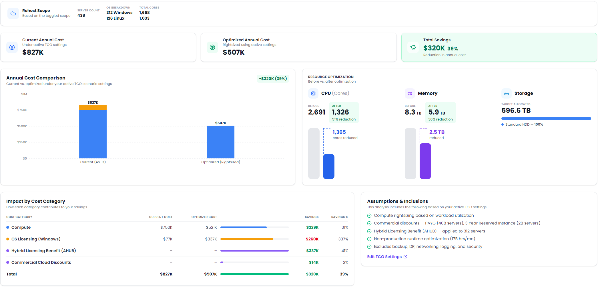
47DFC068-CB45-406A-9ABA-E9E43F90263A
>
>
>
TCO Analysis
Scenario Based
Rehost All
Optimize Impact
Server Optimization & Savings
Rightsizing analysis for the servers targeted at rehost, matching compute and memory allocation to actual utilization to lower ongoing run cost.

Slide 8


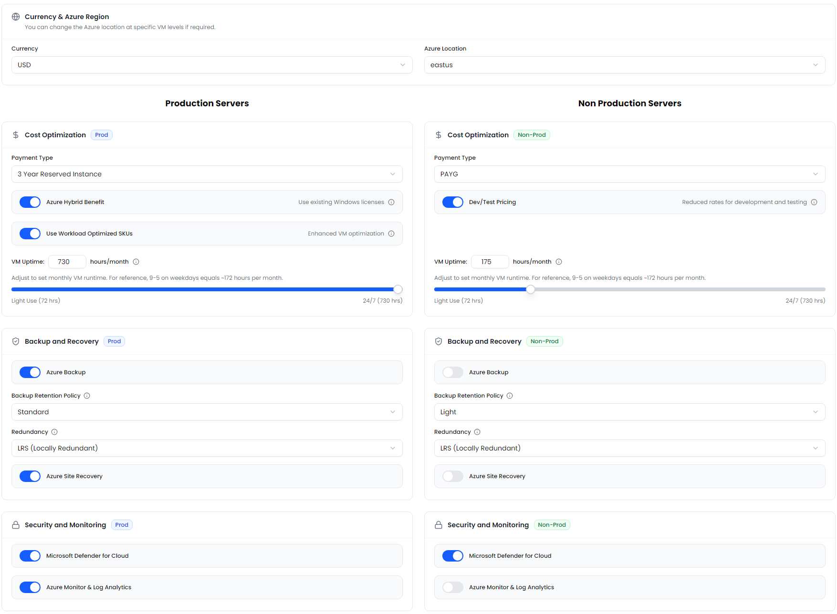
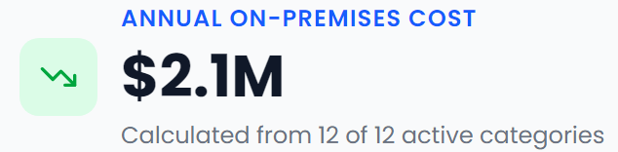
B316F0D1-65F5-49C4-8722-4A1F27ED56ED
>
TCO Analysis
TCO Settings
Key Cost Modeling Configuration Applied
Cost Model Configuration
The financial insights in this report define how cloud costs, optimization opportunities and financial outcomes have been modelled throughout this report.
You're in Control
Every assumption in this report is fully configurable in Dr Migrate. Update pricing, optimization preferences and deployment assumptions to instantly regenerate financial models.
Estimated using industry benchmarks and workload assumptions. Update these values in Dr Migrate to model your own environment.

Slide 9


3ED903B4-1806-405F-8B34-122ED1D0935B
Current Environment Baseline
A clear view of your infrastructure, application estate, and technology risks - forming the foundation for migration and modernization decisions

Slide 10


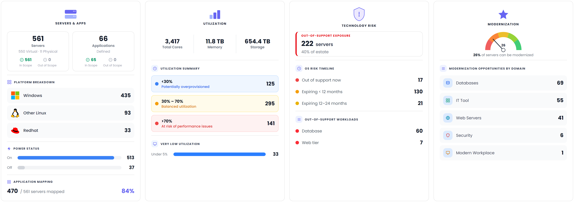
072A9C48-08E1-4630-8541-61CCC4A18002
>
Estate Explorer
Overview
Your Estate Overview
This snapshot summarizes the size, health, risks, and modernization opportunities across your environment.

Slide 11


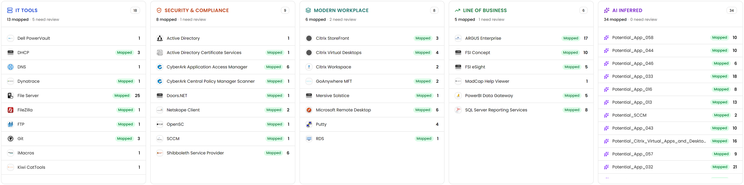
16E99298-2BE6-4F4D-9BFC-A3C0F8CE0F6D
Workload Mapping
>
Auto-Detect
Application Portfolio
Your environment has been catalogued across key technology domains using a combination of our pattern recognition engine and any user-supplied application mappings. These detected technologies form the foundation for assessing modernization opportunities, migration suitability, and potential risks throughout this report.

Slide 12
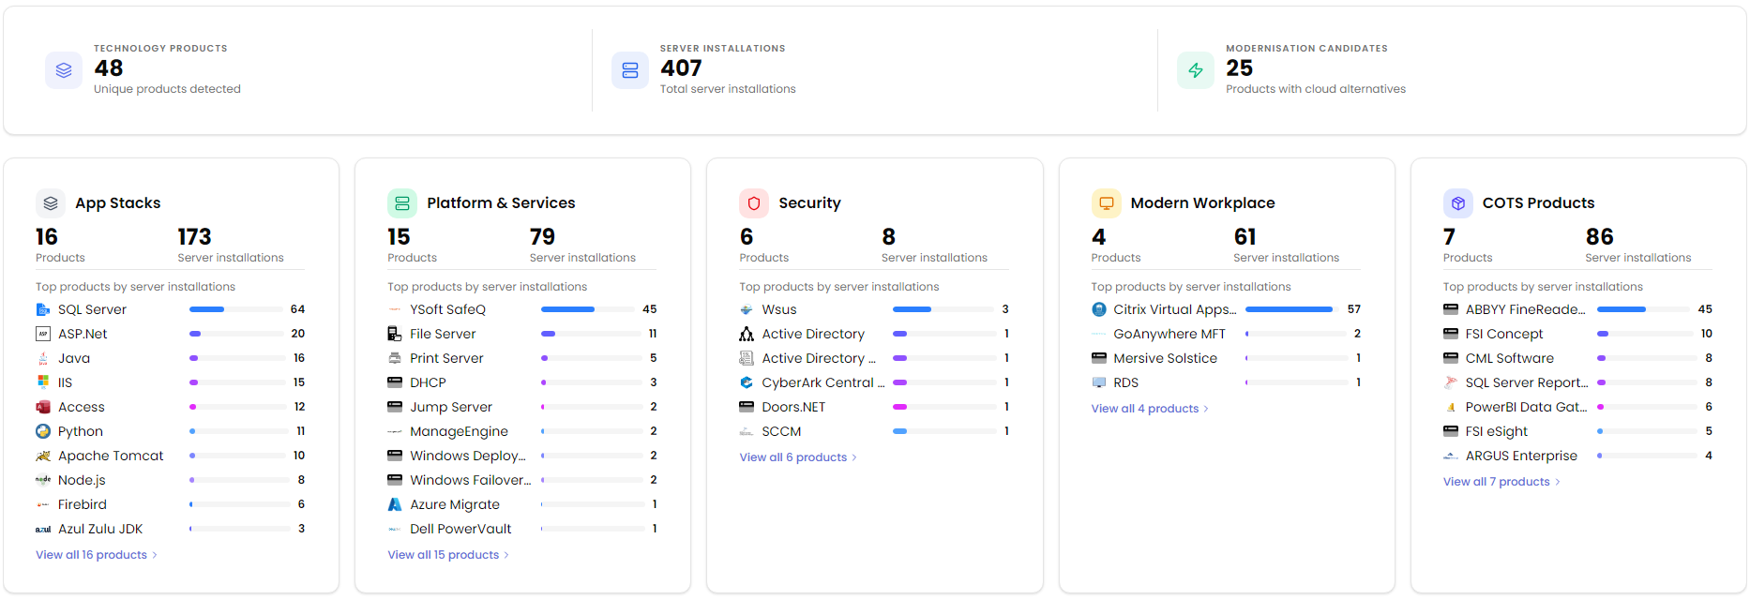
4CF01F4E-DCFB-452B-95F5-DEF0C62F78C6
>
Estate Explorer
Technologies
Technology Domains Analyzed
Technologies discovered across your environment have been grouped into logical domains to simplify analysis, identify trends, and prioritize modernization opportunities. These domains form the foundation for the modernization and risk insights presented throughout this report.

Slide 13

F1A0DE5A-9BEE-45CC-9C95-704174C58D8C
Migration Decisions & Outcomes
Defining the right migration approach for each application â€” from 6R classification to technology platform decisions.

Slide 14
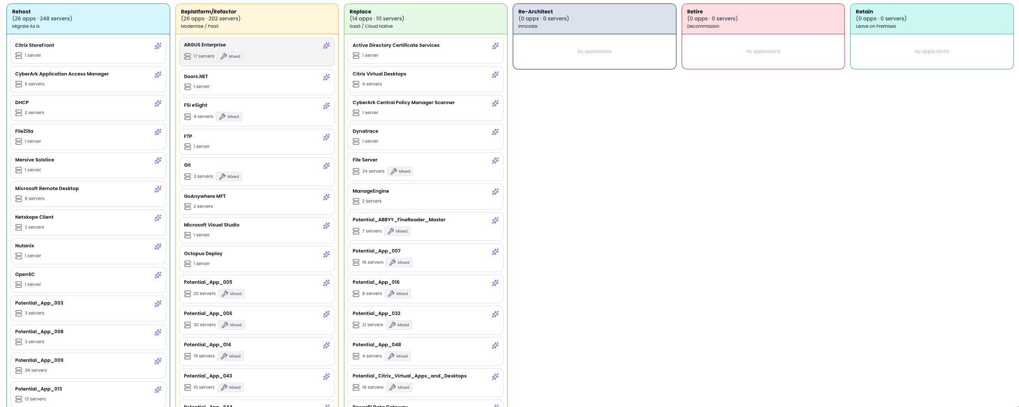
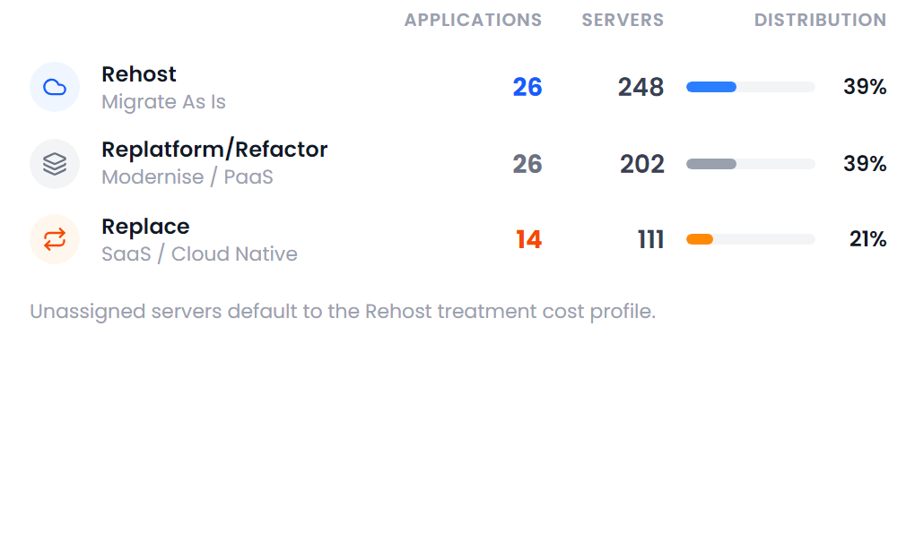
B9055F2E-1F89-4D0F-A779-30076512275D
Migration Treatment Strategy
Applications have been assessed and assigned to their recommended 6R migration treatment based on business, technical, and modernization considerations.

Slide 15
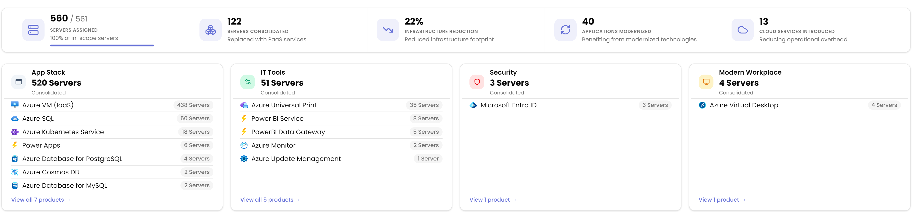
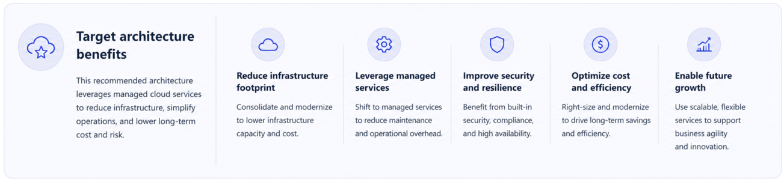
9A802915-A666-460A-BA2D-9D65923188E0
Target Cloud Services
The following cloud platforms and managed services represent the recommended future-state architecture. Selected based on the migration treatments and modernization strategy, they highlight the expected consolidation benefits and reduction in infrastructure footprint.

Slide 16
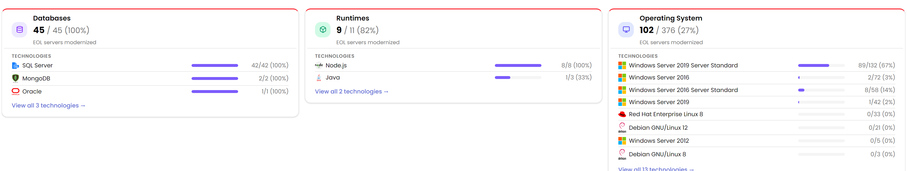
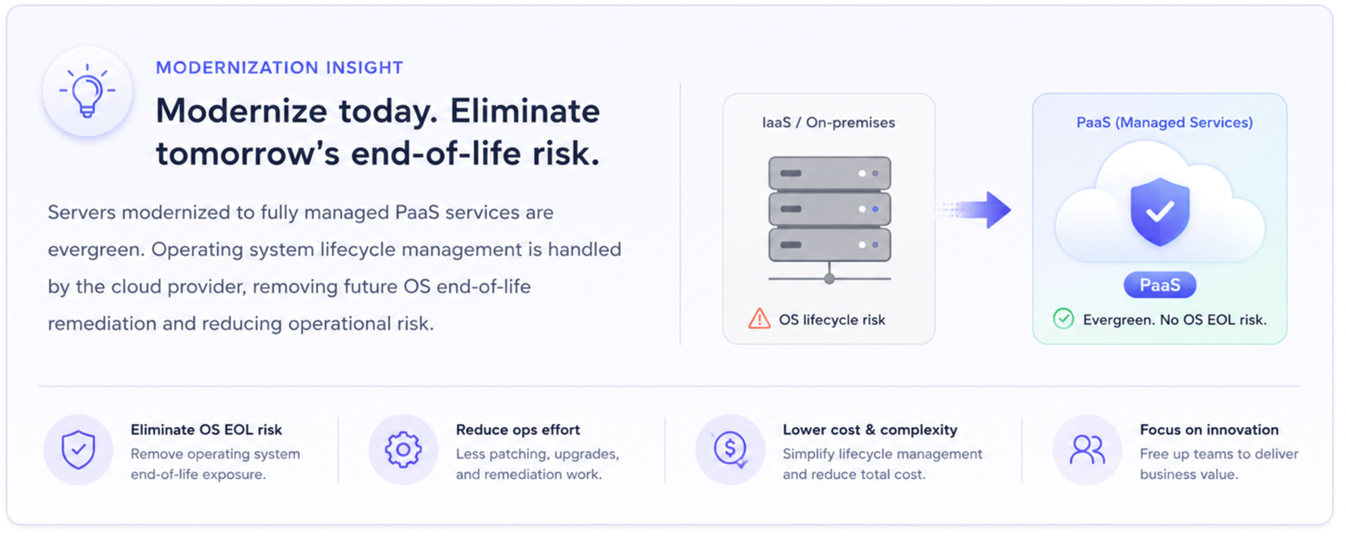
7D162BE9-A647-4DA2-89D6-D0C64ADFE07A
End-of-Life Technology Overview
Technologies approaching or beyond vendor support have been identified across the environment. This view highlights modernization progress and the remaining technology risk to help prioritize remediation and migration activities.

Slide 17

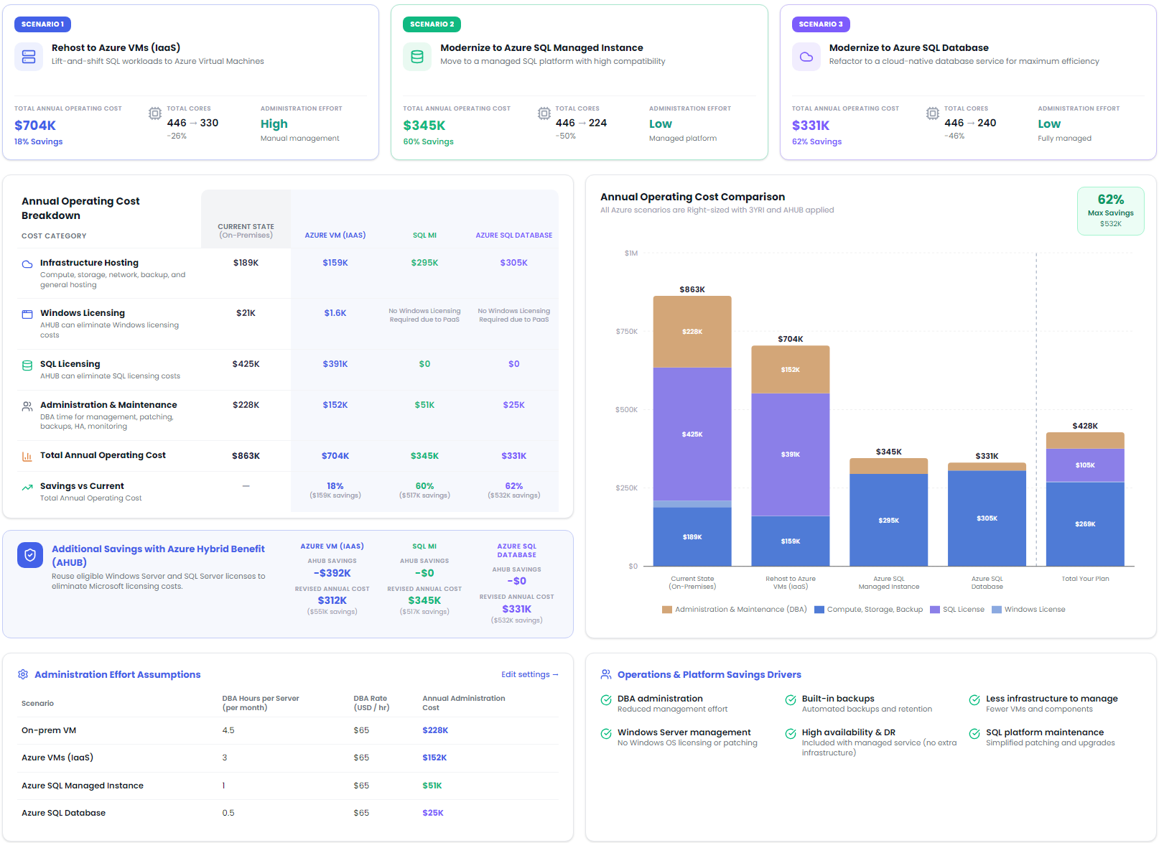
B4D62671-05A0-4EAE-89B7-41BB7E2B3343
TCO Analysis
>
Scenarios
SQL Hosting & Modernization
Compare the projected annual cost, licensing impact, and operational benefits of each Azure SQL migration pathway to identify the best fit for your environment.

Slide 18

3A022B37-6FE1-4BAD-ACDD-B62588EB7929
Execution
Translate migration strategy into an executable delivery plan.

Slide 19

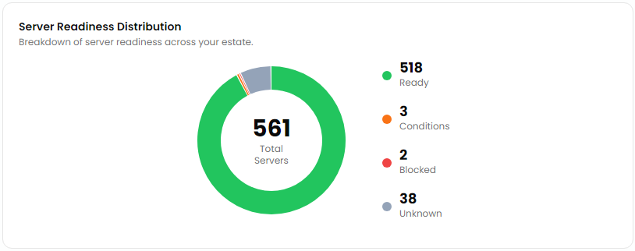
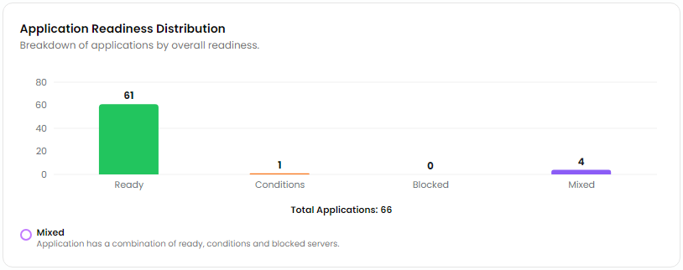
AC39B1D2-71F9-459A-9764-8A0D8DD0A118
>
>
Estate Explorer
Modernization
Cloud Readiness
Rehost Migration Readiness
Applications and servers assigned to the Rehost treatment have been assessed for immediate migration readiness. This view identifies workloads that are ready to migrate, those requiring remediation, and those needing further assessment before deployment.
Server Readiness by Status
Readiness by Application
Server-level assessment showing which systems are ready for lift-and-shift migration and which require remediation or further assessment before deployment.
Application readiness is derived from the status of its associated servers, helping identify low-risk migration candidates and workloads requiring remediation.

Slide 20

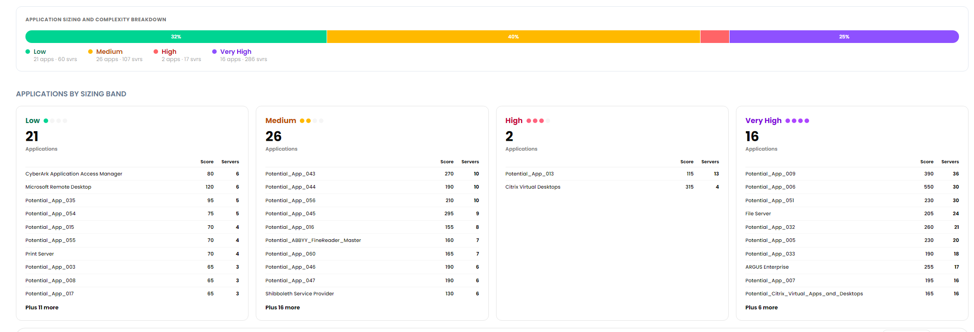
9F8DF1A2-E3F8-4594-8626-CB552ABC3F76
Migration Complexity Assessment
Each application has been assigned a migration complexity score based on factors such as application size, dependency depth, technology stack, infrastructure complexity, and migration treatment. The resulting complexity bands help prioritize migration waves and estimate delivery effort.

Slide 21
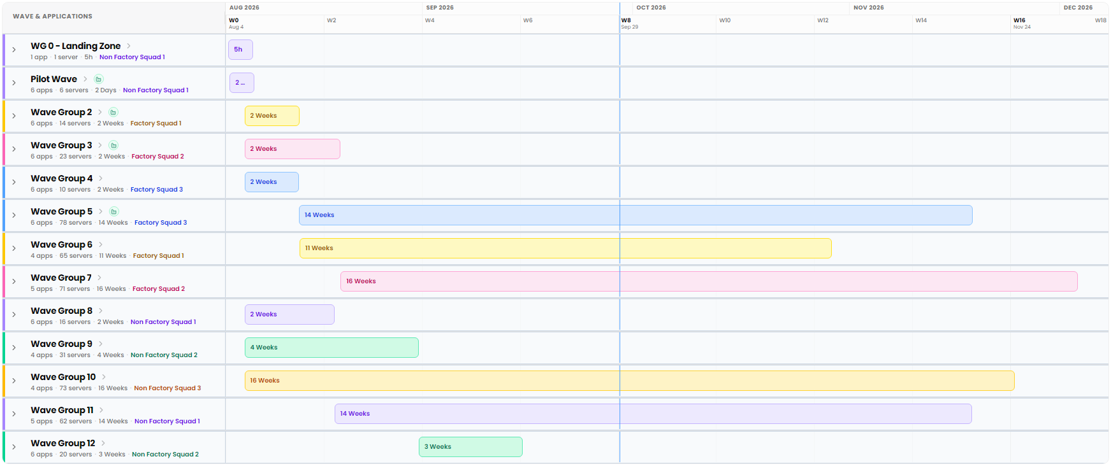
5441D0B0-6355-4EF6-8DD8-95C98A45127E
Migration Wave Plan
An indicative wave plan sequencing workloads by dependency, treatment, and complexity to balance delivery effort across teams.

Slide 22
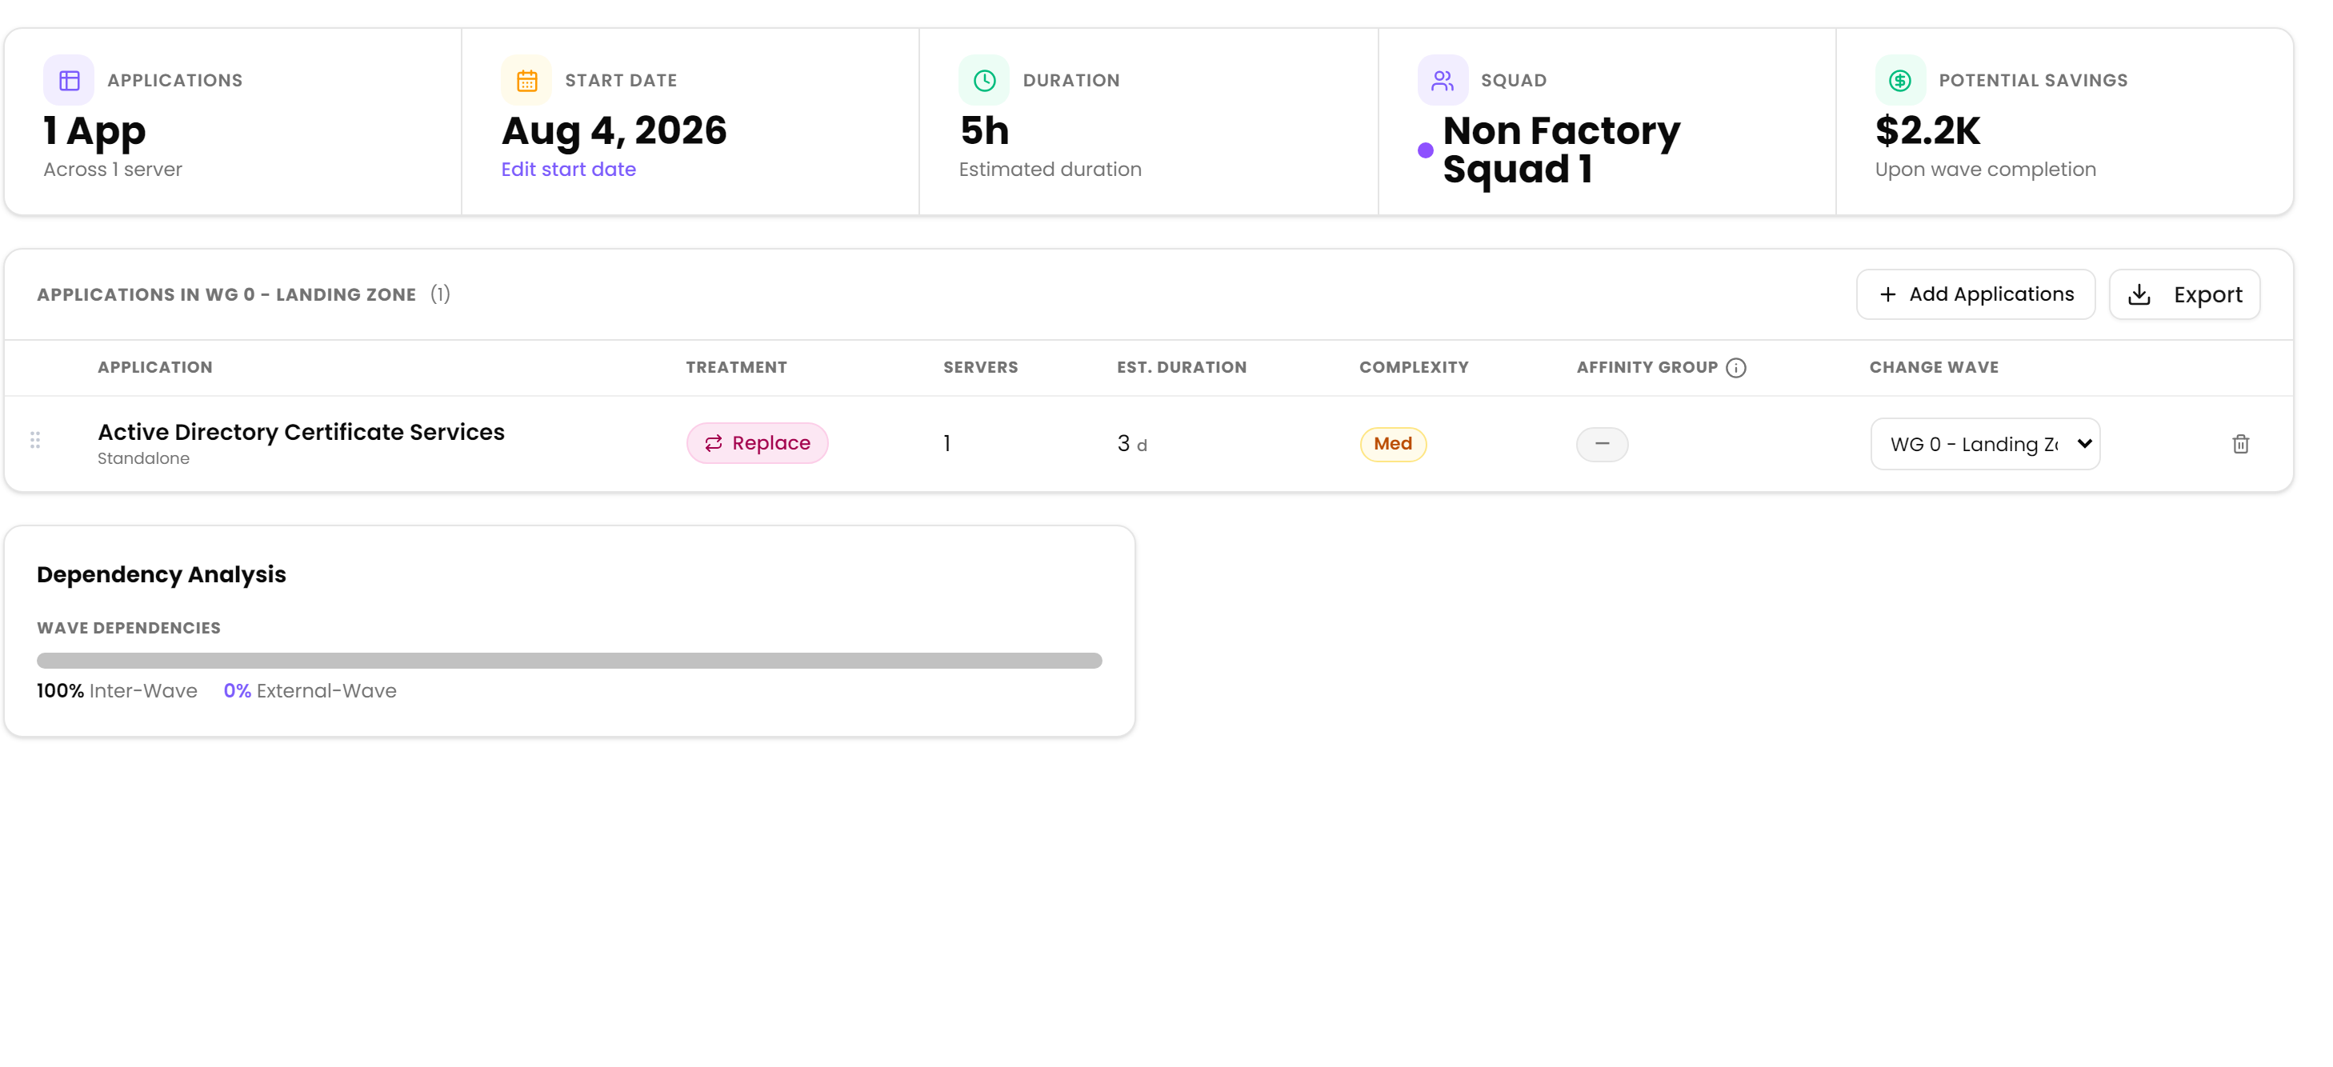
F14EAF8A-FA3A-4D8A-A0EB-0DB4311AA6D9
Migration Wave Details
Wave planning groups applications scheduled for migration together based on dependency relationships, migration treatments, complexity, and overall delivery sequencing. The composition and timing of each wave can be refined during detailed migration planning.

Slide 23
710A8E9C-325B-49F3-8D85-769D77B5AE00
Next Steps & Decision Points
Recommended actions to move from assessment to execution, with clear ownership and decision points for stakeholders.
01
02
03
04
Transition to Continuous Planning
Validate & Approve the Migration Strategy
Prepare the Delivery Platform
Commence Migration Execution
Re-baseline the estate assessment periodically to reflect ongoing changes in the application and infrastructure landscape.
Confirm 6R treatments, wave sequencing, and cost assumptions with business and technical stakeholders before execution begins.
Stand up the landing zone, migration tooling, and governance model required to support execution at scale.
Begin execution of Wave 1, applying lessons learned to refine the approach for subsequent waves.
Schedule recurring Dr Migrate reassessments
Track changes in application and infrastructure inventory
Update stakeholders on estate drift
Finalize landing zone architecture
Select and configure migration tooling
Define governance and escalation model
Kick off Wave 1 migration activities
Monitor progress against plan
Capture lessons learned for future waves
Review treatment decisions with application owners
Validate wave grouping and sequencing logic
Sign off on cost and effort assumptions
OUTCOME
OUTCOME
OUTCOME
OUTCOME
Continuously accurate estate visibility
Approved migration strategy and plan
Execution-ready delivery platform
Migration underway with continuous feedback

Slide 24
BAA38C2E-D27E-4808-B525-934523BCBE20
Appendix
Additional insights.

Slide 25
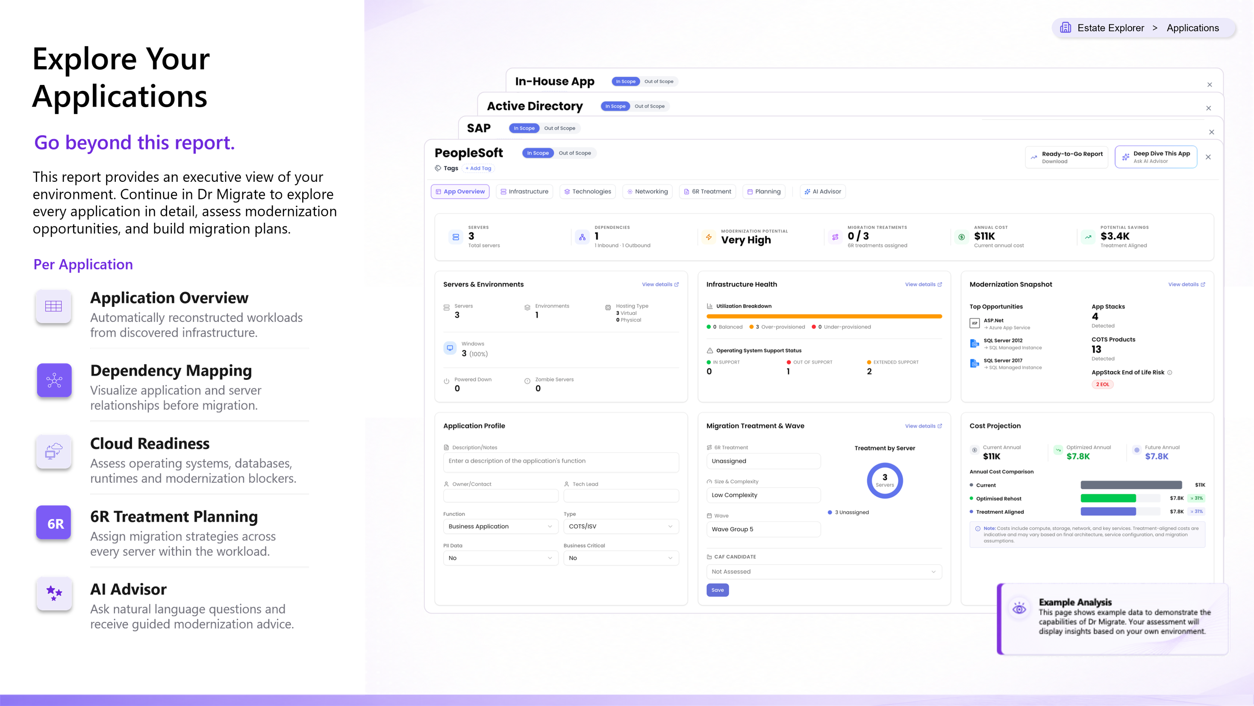
B1F8D68E-B690-4178-A34C-FFA5D34E2FB5

Slide 26

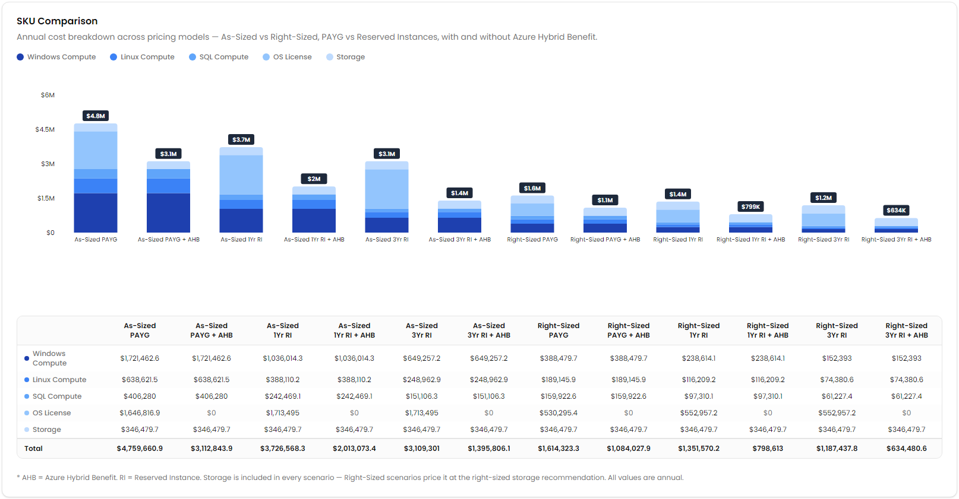
14548395-7C62-4AE5-81A8-1C6A4143FCF6
TCO Analysis
>
Scenarios
IaaS Hosting
Cost Comparison
Compare projected annual infrastructure costs across Azure hosting, commitment, and right-sizing scenarios to identify the most cost-effective deployment model.

Slide 27

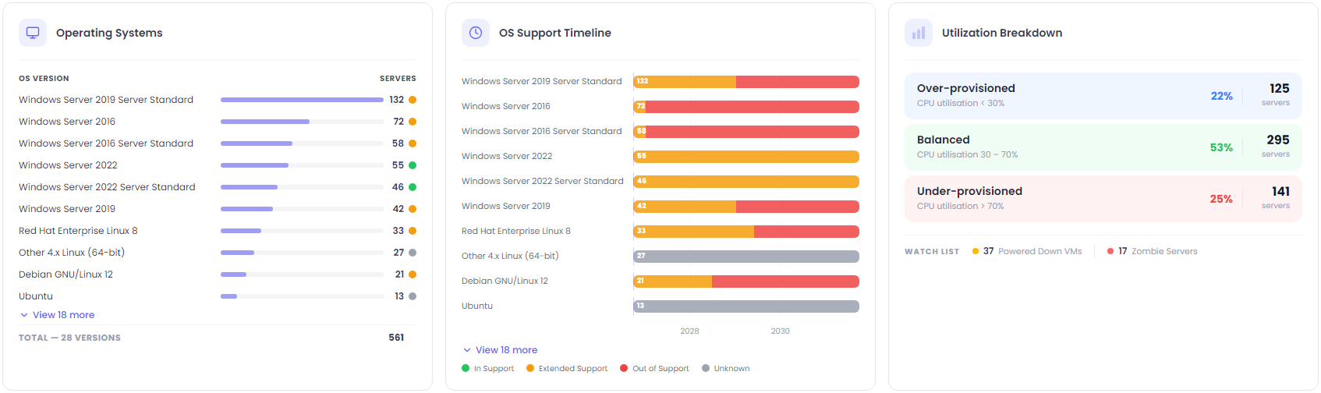
8ABA3476-A28C-4D40-AA80-9BF6E26DF846
>
>
Estate Explorer
Infrastructure
Servers
Server Analysis
A high-level summary of the server landscape, including operating system distribution, support status, utilization patterns, and potential opportunities to optimize or decommission underused infrastructure.

Slide 28
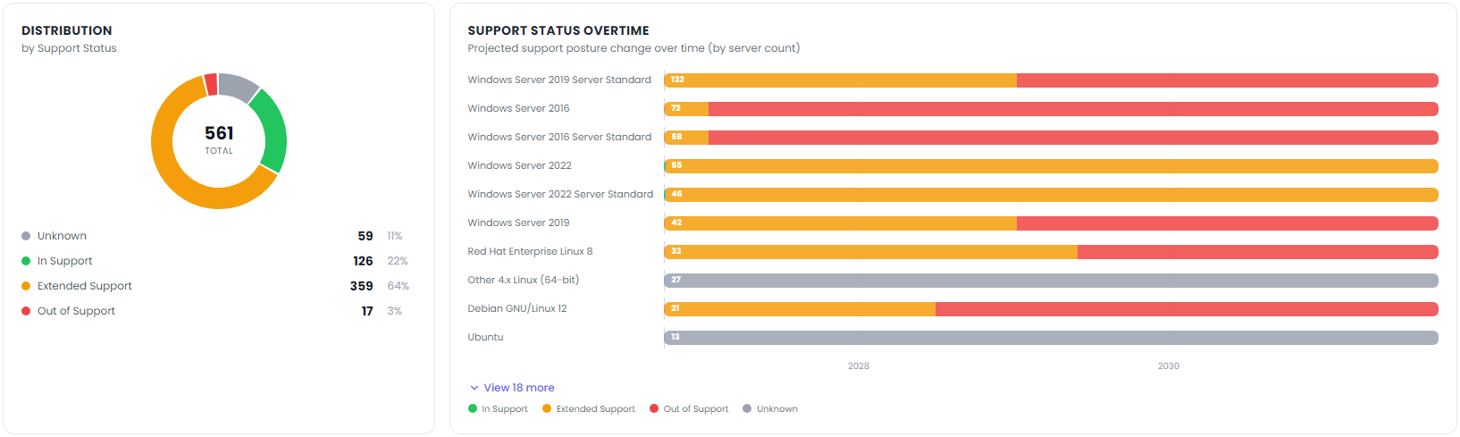
A3A496D5-B3E1-4A98-9EDF-A218CE4310F6
>
Estate Explorer
Infrastructure
>
Servers
Operating System Lifecycle Risk
Identify unsupported operating systems, upcoming end-of-support milestones, and infrastructure requiring remediation to reduce security and operational risk.

Slide 29
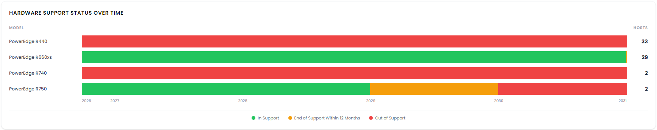
7837F4E9-E66C-4EAD-AB7D-3E61D684A20F
>
Estate Explorer
Infrastructure
>
Hardware
VMware Hosting Infrastructure Support
Review the support status of the physical infrastructure hosting your VMware environment. Identify aging hardware, warranty expiry, and end-of-support exposure.
Warranty Assumption: Hardware is purchased within 5 years of the release date and with 3 years of warranty. Does not account for if extended warranty was purchased
*Powered down machines do not report make or model.

Slide 30

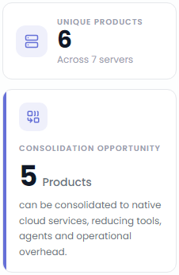
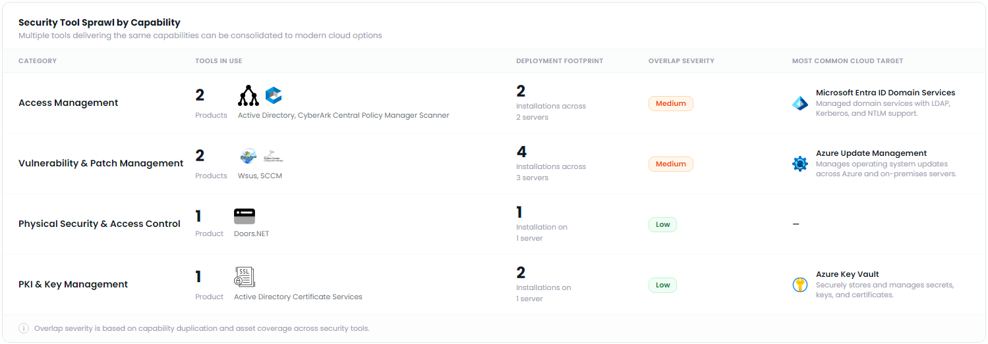
FFE4531D-746A-4449-845C-D23F7BC2A134
Estate Explorer
>
Technologies
>
Security
Security Modernization Opportunities
Security Tooling Consolidation
Identify overlapping security capabilities and consolidate onto modern cloud-native security platforms to simplify operations and reduce cost.

Slide 31

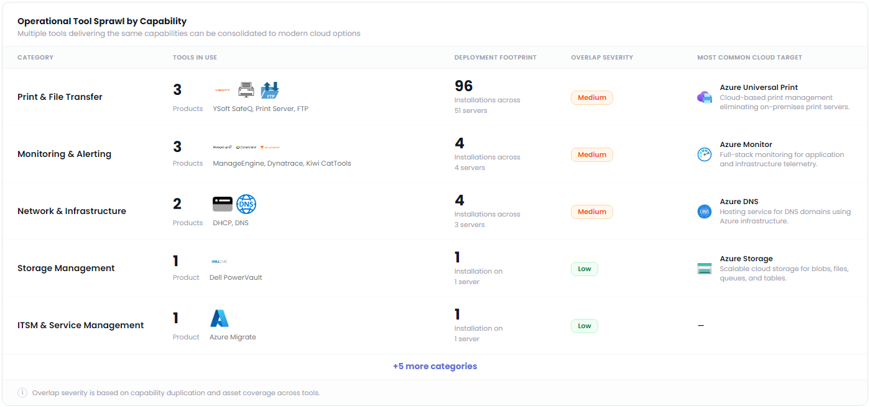
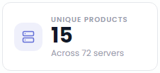
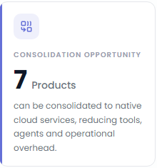
E3AD19DE-EE6A-4B99-8B2C-A1B21BDC721D
>
Estate Explorer
Technologies
Platform & Services
>
Platform & Services Modernization Insights
Platform Services Consolidation Opportunity

Slide 32

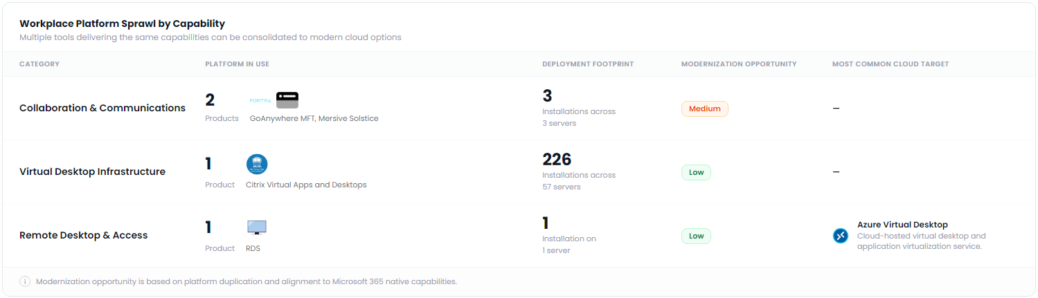
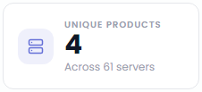
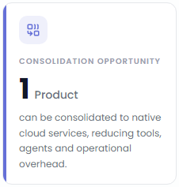
ABAE442C-4B2C-434E-927D-34DB8DBE4FF3
>
>
Estate Explorer
Technologies
Modern Workplace
Modern Workplace Modernization Insights
Modern Workplace
Consolidation Opportunity
Your workplace environment presents opportunities to consolidate remote access, collaboration, and endpoint management onto cloud services. This reduces platform sprawl while improving security, governance, and the employee experience.

Slide 33

7EAE7DAA-1DDD-4F5F-8321-5A45511A9335
Cloud and SaaS Services
Identify opportunities cloud hosting services assessed and initial opportunities

Slide 34

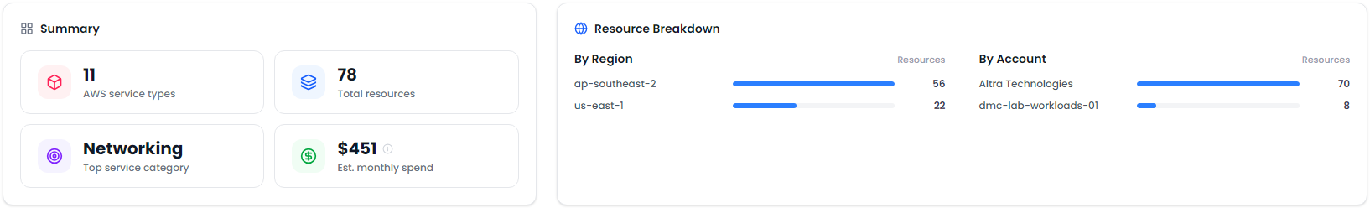
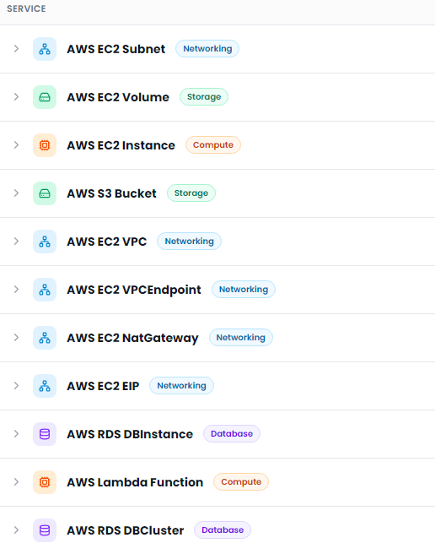
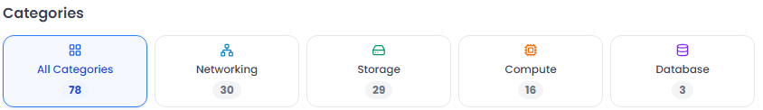
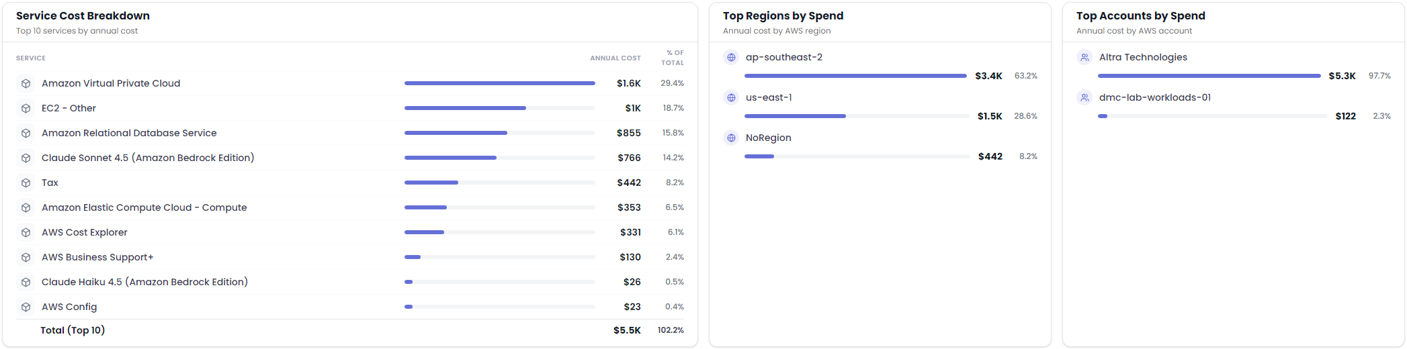
093D2011-2D75-4C0A-B36D-0A1CDB9CE27E
Estate Explorer
Infrastructure
AWS
>
>
AWS Services and Cost Overview
AWS Service Inventory
Review the services discovered across connected AWS accounts, including resource inventory, service categories, regional distribution, and estimated cloud expenditure.
Gain a clear view of your AWS landscape, including discovered services, resources distribution and estimated spend across your environment.

Slide 35
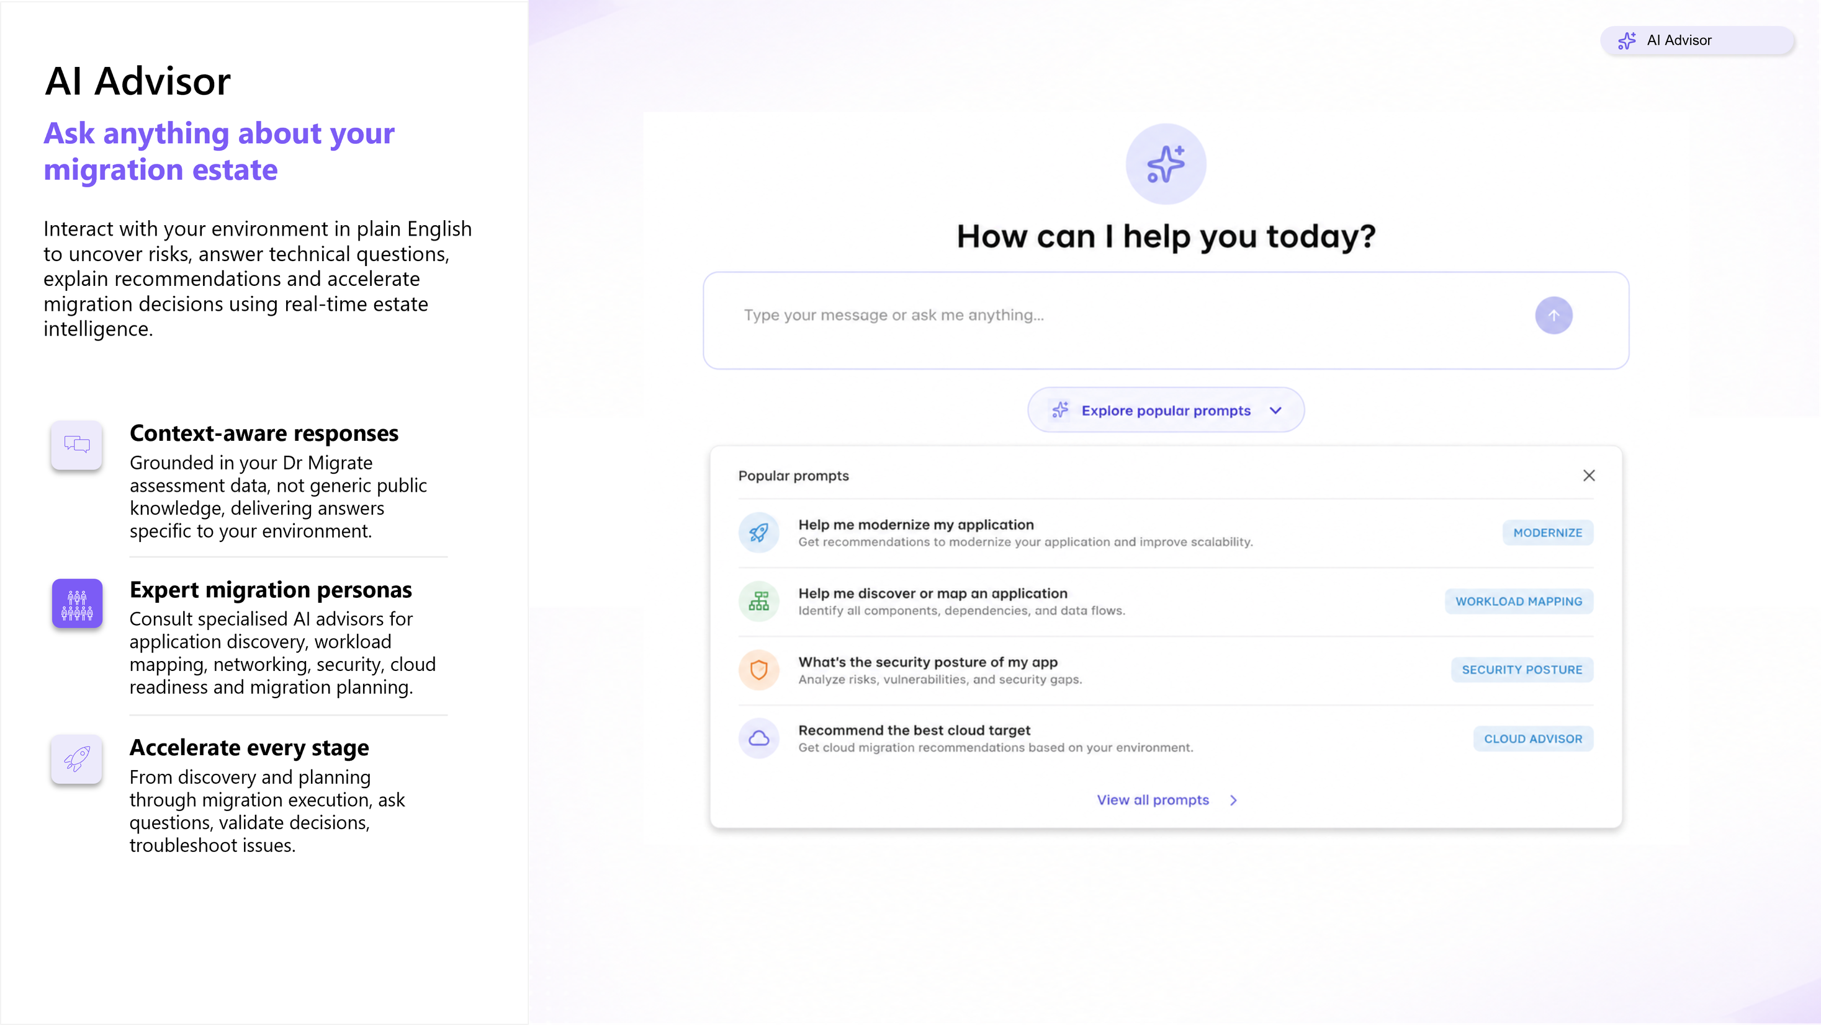
0DC523BE-5456-4982-8A50-776D755809DD

