Slide 1
DAF2F42A-6223-4C27-8F9B-3E5EFBBD51F6
Rapid Insights
Prepared for: Contoso
Complete Scope
Prepared by

Slide 2
5C36D63A-2DFA-4B4C-8758-0516EDE93919
Report Contents
This assessment provides an executive overview of your environment, highlighting key risks, optimization opportunities, modernization readiness, and migration potential. Continue your journey in Dr Migrate to build a prioritized migration roadmap and execution plan.
Executive Summary
Infrastructure
Modernization
Assessment Scope
Servers
Application Stacks
Financial Scenarios
Storage
Security Services
Optimization
IT Platforms & Services
Modern Workplace
Cloud & SaaS
Note: Each page includes a navigation breadcrumbs showing where to access live insights in Dr Migrate.
Estate Explorer
Modernization

Slide 3
5F1D8B67-E782-4493-8337-050F9AF270E2
Estate Explorer
Overview
>
Your Estate Overview
This snapshot summarizes the size, health, risks, and modernization opportunities across your environment.
Notes:
- The estate is large enough that decisions now need to be portfolio-based, not server-by-server. The important point is the mix: a predominantly Windows footprint, meaningful Linux presence, and only partial application mapping. That tells us migration planning is feasible, but not yet reliable enough to lock in wave plans, business case assumptions, or target architectures without more dependency discovery.
- There is a clear efficiency opportunity. A meaningful portion of the environment appears oversized, while another segment is running hot. That usually means spend is being absorbed in the wrong places: excess capacity in some workloads and potential performance risk in others. Before migration, rightsizing and demand profiling should be used to avoid carrying waste into Azure and to prevent underestimating production requirements.
- The out-of-support exposure is the most immediate executive risk. This is not just a technical lifecycle issue; it affects security posture, audit exposure, resilience, and the cost of maintaining unsupported platforms. The concentration in database and web tiers is particularly important because those are business-critical layers and often the hardest to remediate late.
- Modernization potential is material, especially around data and application-serving layers. That suggests this should not be treated as a pure infrastructure exit. There is room to improve agility, patching, and operational resilience if migration is paired with selective platform modernization.
- Operational maturity is mixed. Power-state and mapping data indicate some governance exists, but not enough to confidently optimize the estate. Executives should expect a short discovery phase focused on dependencies, supportability, and business criticality before committing to sequencing or funding levels.
The following has been generated by AI. Consider checking important facts.

Slide 4
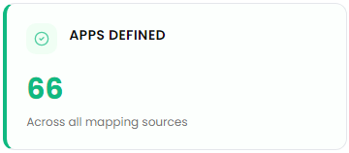
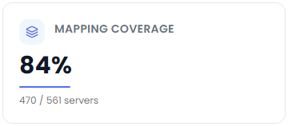
E10F6574-8E80-4914-9425-660DA98D2C27
Workload Mapping
>
Auto-Detect
Key Application Workloads Discovered
A pattern recognition engine has catalogued your environment across key technology domains.
These detected products form the foundation for assessing modernization opportunities risks and migration potential throughout this report.
Improve Detection Accuracy
Dr Migrate automatically identifies application workloads using software,
services, and behavioural patterns. Importing CMDB or server-to-application
mappings further improves detection accuracy and planning outcomes.
Notes:
- The important takeaway is not the inventory itself, but the shape of the estate: this is a mixed environment with core infrastructure services, end-user computing, security tooling, and business applications all tightly intertwined. That usually means migration cannot be treated as a server move exercise; it has to be sequenced around service dependencies and user impact.
- Coverage is directionally strong, but not complete enough to lock a full migration plan with confidence. The combination of mapped workloads, items needing review, and AI-inferred applications tells us discovery is mature enough to identify patterns, but still has ambiguity in ownership, dependency validation, and criticality. That is a planning risk if teams move too quickly into wave design.
- The presence of identity, certificate, privileged access, and endpoint management components raises the bar for governance. These are control-plane services. If they are not stabilized early, they become blockers for everything else—application access, admin operations, compliance, and recovery.
- The end-user computing footprint suggests a meaningful opportunity to modernize workplace delivery, but also a trade-off: rapid hosting changes may preserve technical debt, while deeper modernization can reduce support complexity and improve resilience. Executive alignment is needed on whether the goal is speed, simplification, or user experience.
- The inferred application set is valuable because it points to hidden business services that may not have clear documentation. That is where outages and cost overruns typically originate. The next step should be targeted validation with app owners and CMDB/server-to-app mapping before committing migration waves.
- This level of discovery is enough to start segmentation: retain, rehost, replatform, or retire. That decisioning will drive Azure landing zone design, security controls, and cost modeling far more effectively than treating every workload the same.
The following has been generated by AI. Consider checking important facts.

Slide 5
CEF6A2C6-8EEA-44AD-9C86-5B9BC19FFAB8
Financial Scenarios
Explore three forward-looking scenarios to help shape your migration strategy.

Slide 6

8854F664-86A2-49A3-8A57-55B7A3239180
TCO Analysis
TCO Settings
>
Key Cost Modeling Configuration Applied
Cost Model Configuration
The financial insights in this report define how cloud costs, optimization opportunities and financial outcomes have been modelled throughout this report.
You're in Control
Every assumption in this report is fully configurable in Dr Migrate. Update pricing, optimization preferences and deployment assumptions to instantly regenerate financial models.
Estimated using industry benchmarks and workload assumptions. Update these values in Dr Migrate to model your own environment.

Slide 7
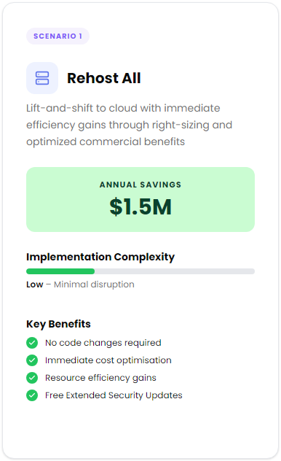
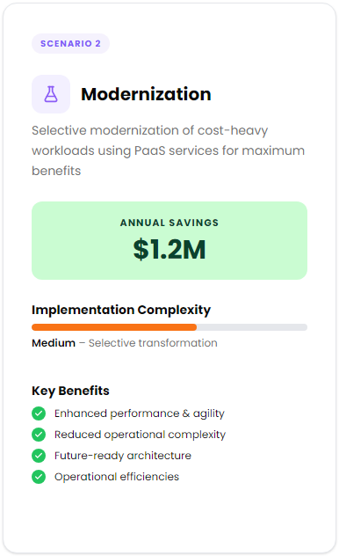
E6692271-B14D-4A61-9EC1-F10B7CEF8ADE
TCO Analysis
Scenarios
>
Migration Scenarios
These example scenarios illustrate potential migration pathways to Azure - each offering different levels of transformation, complexity, and benefit.
While directional in nature, they serve as a starting point for discussion and can be tailored in the next planning phase to align with your unique strategy, timeline, and platform goals.
Use Dr Migrate's Planning Platform to assign treatment strategies across your estate and generated costs tailored to your actual workloads.
Notes:
- The important message is that both paths create value, but they optimize for different executive outcomes. Rehost favors speed, lower disruption, and faster financial capture. Modernization favors longer-term operating model improvement, but with more delivery dependency and change management.
- The fact that rehost produces stronger near-term savings is a signal that the current estate likely has meaningful infrastructure inefficiency today. That usually points to oversized servers, aging support commitments, and limited elasticity. In planning terms, this argues for treating migration not just as a hosting move, but as an immediate cost and risk reduction lever.
- Modernization showing lower direct savings does not make it the weaker option. It suggests the real benefit shifts from infrastructure reduction to business agility, resilience, and reduced operational friction. Executives should view this as an investment case, not purely a cost case.
- The risk is choosing a single strategy for the entire estate. A uniform lift-and-shift approach can preserve technical debt. A broad modernization mandate can slow the program, increase execution risk, and delay value realization. The right answer is usually workload segmentation.
- This should influence sequencing decisions: move low-complexity workloads first to capture savings and security improvements, then target cost-heavy or business-critical applications for selective modernization where platform services materially improve supportability and uptime.
- The next planning step is deeper workload discovery: dependency mapping, licensing position, resilience requirements, and application lifecycle status. That is what increases confidence in wave planning, governance controls, and the business case.
The following has been generated by AI. Consider checking important facts.

Slide 8
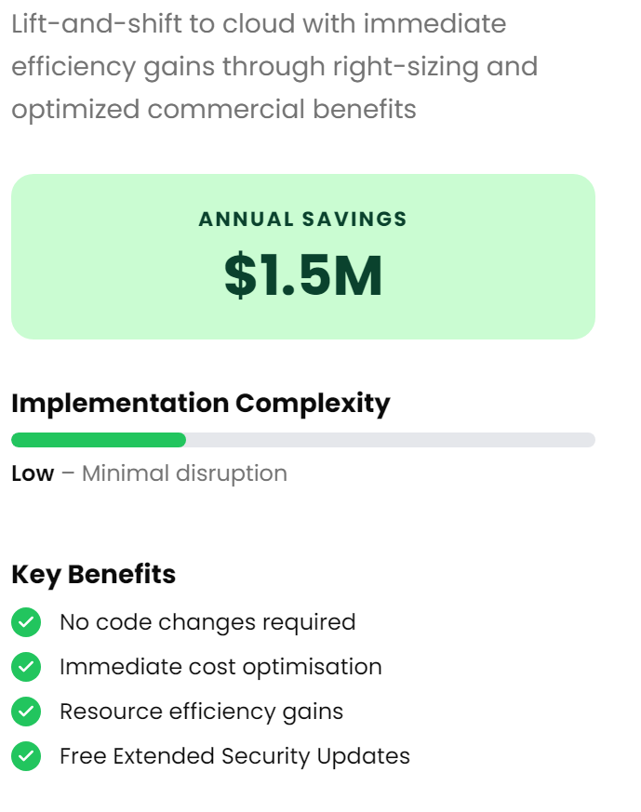
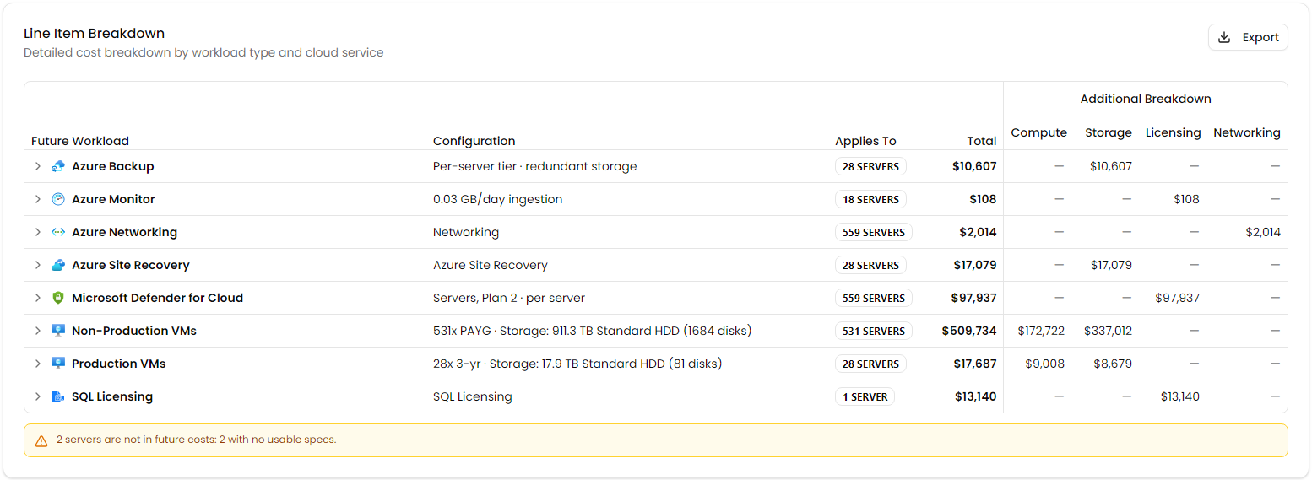
A0AC9FC4-916E-4979-B8F9-E8B4C1F6F062
TCO Analysis
Scenarios
>
Scenario 1
Rehost All
Rehost - Cost Breakdown
Notes:
- The headline here is that a straight rehost already creates material financial headroom. That matters because it means the business does not need to wait for full application modernization to start capturing value. You can use early savings to help fund later phases such as platform remediation, security uplift, and selective refactoring.
- The biggest signal in the cost profile is that this estate is largely infrastructure-heavy, not transformation-heavy. In other words, much of the current spend appears tied to server footprint, storage, and licensing rather than differentiated application capability. That usually indicates meaningful rightsizing opportunity, but also suggests some workloads may be carrying historic overprovisioning into the cloud unless performance data is validated.
- Implementation complexity is low, which is attractive for speed, but executives should not confuse low migration effort with low operational risk. Rehosting moves the estate; it does not inherently improve architecture, resilience, patching discipline, or governance. Without a post-migration plan, you can simply relocate technical debt.
- Licensing and backup or recovery components are important here because they often determine whether projected savings are sustainable. This should influence decisions on Azure Hybrid Benefit, reservation strategy, disaster recovery scope, and which systems truly require premium protection.
- The excluded or unusable server specifications are a planning risk. Even a small number of unknowns can distort migration sequencing, dependency mapping, and business continuity assumptions. More discovery would improve confidence before committing to a wave plan.
- The executive takeaway: rehost is a credible first move for rapid savings and minimal disruption, but it should be treated as phase one of a broader modernization and governance roadmap, not the end state.
The following has been generated by AI. Consider checking important facts.

Slide 9

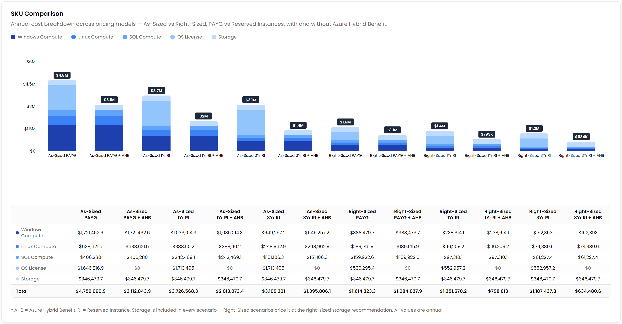
9CCCB8A5-654C-423A-B898-5E7126510927
TCO Analysis
Scenarios
>
IaaS Hosting
Cost Comparison
Compare projected annual infrastructure costs across Azure hosting, commitment, and right-sizing scenarios to identify the most cost-effective deployment model.
Notes:
- The core message is that cost reduction is not coming from one lever; it comes from sequencing three decisions together: fix oversizing, commit where demand is stable, and apply existing license entitlements. If executives treat this as only a hosting move, they will leave a meaningful portion of value unrealized.
- The biggest signal here is maturity gap, not just price variance. A large spread between as-is and optimized scenarios usually means the current estate has inconsistent sizing discipline, weak lifecycle governance, or limited visibility into actual utilization. That has implications beyond cost: it often correlates with operational complexity and patching, backup, and resiliency inefficiencies.
- Storage appears comparatively fixed, which matters because it tells us compute and licensing are the primary optimization levers. In planning terms, that means migration savings will depend less on “move it to cloud” and more on workload rationalization, performance baselining, and commercial posture.
- Reserved capacity delivers strong economics, but it introduces a commitment risk. The leadership question is whether demand is predictable enough to lock in term commitments now, or whether a phased approach is needed until application retirement, modernization, and business seasonality are better understood.
- Azure Hybrid Benefit changes the business case materially, which means licensing governance becomes a board-level migration dependency. If entitlement data is incomplete, forecast confidence is overstated.
- The next decision should be workload segmentation: which systems are stable enough for commitment, which require right-sizing first, and which should be modernized rather than simply rehosted.
The following has been generated by AI. Consider checking important facts.

Slide 10


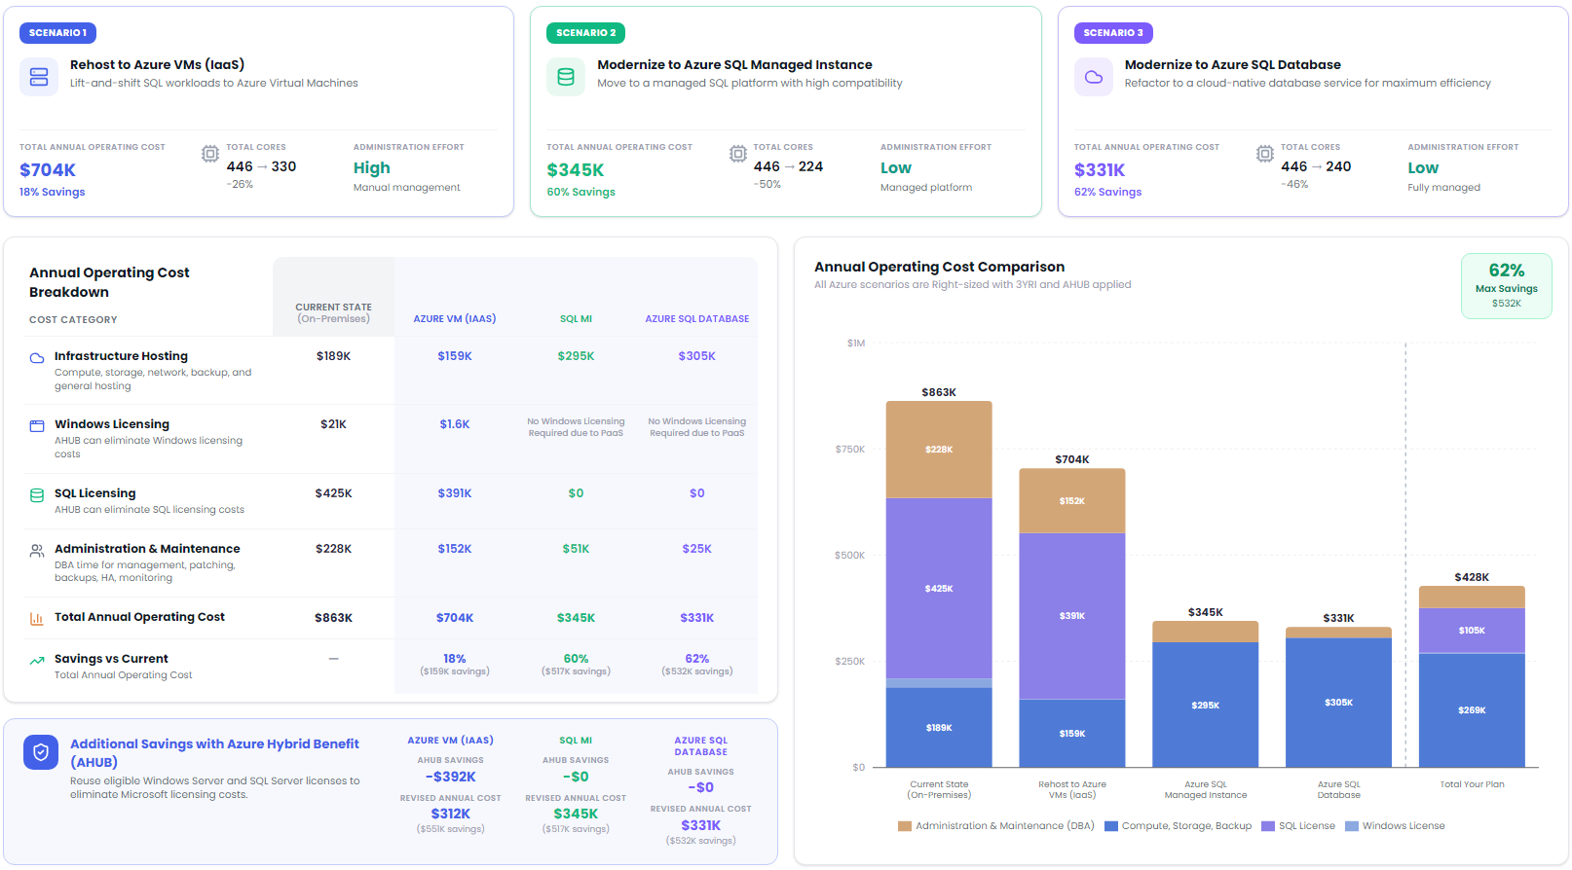
DCE3571F-EE7B-41EB-B74F-B6D089A43A94
TCO Analysis
Scenarios
>
SQL Hosting & Modernization
Compare the projected annual cost, licensing impact, and operational benefits of each Azure SQL migration pathway to identify the best fit for your environment.
Notes:
- The biggest message here is that the economics improve materially only when the organization is willing to modernize, not just relocate. A straight rehost reduces some cost, but it preserves much of the operational model, so the business keeps paying for administration, patching, and platform ownership.
- The licensing profile is doing a lot of the work in the current estate. That tells us SQL is likely overrepresented in the cost base relative to infrastructure alone. For executives, that means migration planning should not start with servers; it should start with workload classification, SQL edition usage, and dependency mapping, because rightsizing the database platform is where the value sits.
- The managed options also signal a maturity opportunity. Moving to platform-managed SQL shifts effort away from routine maintenance and toward governance, performance engineering, and application change. That is not just an IT efficiency story; it reduces key-person risk and improves resilience.
- The strategic trade-off is compatibility versus optimization. Managed Instance is usually the lower-risk modernization path for existing SQL estates, while Azure SQL Database delivers the strongest long-term efficiency when applications can be refactored. The decision should be driven by remediation appetite, not just cost.
- Executives should also read this as a governance issue. If administration remains high, cloud will not deliver its full value. Landing zone discipline, policy, backup standards, and FinOps controls need to be established early or savings will erode after migration.
- The next step is targeted discovery: identify business-critical databases, feature dependencies, HA/DR requirements, and licensing entitlements. That will materially improve confidence in which workloads can be modernized now versus staged over time.
The following has been generated by AI. Consider checking important facts.

Slide 11

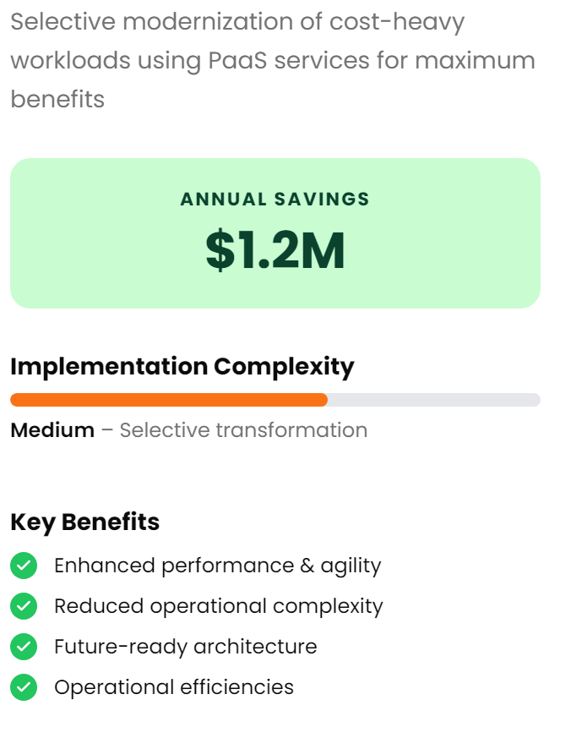
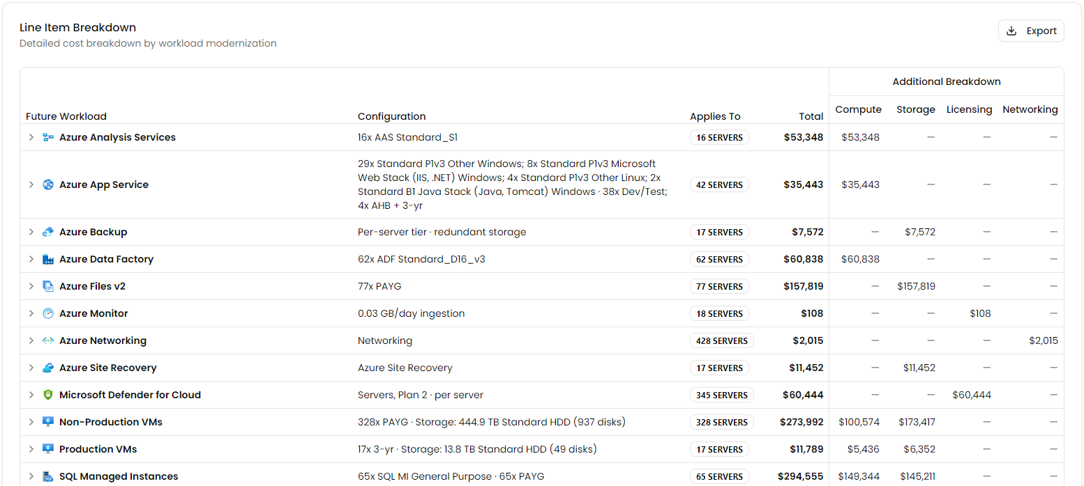
728FF2BB-6E6C-499A-B9CC-ED65E49E2967
TCO Analysis
Scenarios
>
Scenario 2
Modernization
Modernization - Cost Breakdown
Tailor this Scenario
This is just one possible migration scenario. Use Dr Migrate's Planning Platform to assign 6R treatment strategies across your applications and generate a migration plan tailored to your environment.
Notes:
- The important story here is not just cost reduction; it is that selective modernization is targeting the parts of the estate where infrastructure-heavy operating models are masking inefficiency. That tells us there are likely a subset of applications consuming disproportionate run costs and administration effort, making them strong candidates for platform-based redesign rather than simple rehosting.
- The savings profile suggests this organization can materially reduce steady-state infrastructure spend while also simplifying operations. That matters because lower run cost is only part of the value; the bigger executive benefit is less patching, less platform maintenance, and fewer failure points. This typically improves release speed and resilience at the same time.
- The medium implementation complexity is a useful signal. It implies this is achievable without a full estate rewrite, but it is not a lift-and-shift exercise either. Success will depend on application dependency mapping, data integration design, and clear business ownership for the workloads being modernized.
- There is also a governance implication: once services move to more managed platforms, cost control shifts from server sizing to service consumption, data growth, and architecture discipline. Without FinOps guardrails, tagging, and policy, savings can erode over time.
- Security and recovery should improve if modernization is done well, but they need to be designed in upfront. Identity, secrets management, backup, and platform monitoring become foundational rather than optional.
- Executive decision: treat this as a targeted transformation wave. Prioritize the most expensive and operationally fragile workloads first, and validate application readiness before committing to a broader modernization program.
The following has been generated by AI. Consider checking important facts.

Slide 12

0D89B313-863A-4499-B876-E5D5C7E712E9
Infrastructure Findings
Understand your server estate across OS, migration readiness, and support risks.

Slide 13

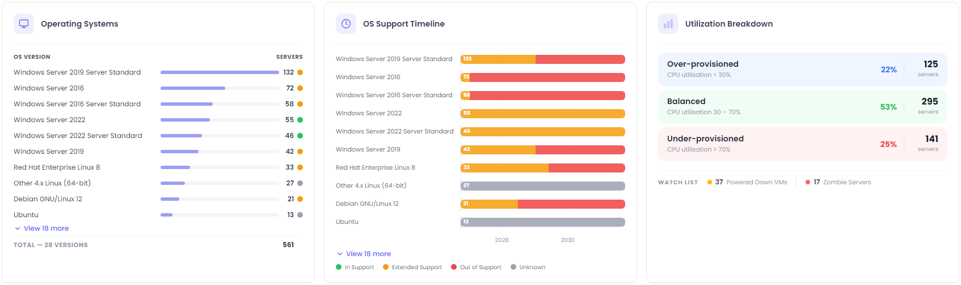
78CFDED0-5419-48C9-8BB0-300915711213
Estate Explorer
Infrastructure
Servers
>
>
Server Analysis
A high-level summary of the server landscape, including operating system distribution, support status, utilization patterns, and potential opportunities to optimize or decommission underused infrastructure.
Notes:
- The first takeaway is operational drag: this is a predominantly virtual estate with a long tail of OS versions and support states. That combination usually signals inconsistent standards, uneven patching discipline, and higher effort for security, backup, monitoring, and audit readiness. The issue is less the server count and more the fragmentation.
- A large portion of the environment sits in extended, out-of-support, or unknown status. That creates a direct security and compliance concern, but it also affects migration economics. Older platforms are often the hardest to move cleanly, so these workloads should be separated into retire, rehost, and remediate paths early rather than treated as one program.
- Utilization is telling two stories at once: there is clear waste from over-provisioning, but also evidence of performance risk from under-provisioned systems. That points to weak capacity management. Rightsizing before or during migration will materially improve the business case and reduce the chance of simply relocating inefficiency into Azure.
- The amount of memory and storage relative to server count suggests meaningful savings may sit in storage tiering, backup rationalization, and decommissioning inactive systems, not just compute. Powered-down and zombie servers are immediate candidates for cleanup.
- Executives should see this as a governance opportunity: establish a supported OS baseline, enforce lifecycle ownership, and define exception handling. Azure Policy, Update Manager, Arc, and Defender can help, but only after ownership and standards are clarified.
- Confidence in the plan would improve with one more level of discovery: application dependency mapping, business criticality, and license position. That is what turns infrastructure data into a sequenced modernization roadmap.
The following has been generated by AI. Consider checking important facts.

Slide 14
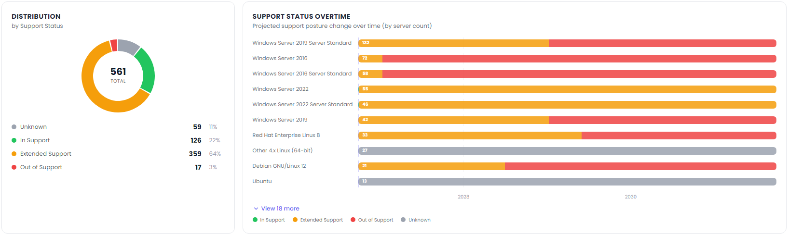
18106905-3B53-4E2C-BBF5-1F4FCCFCAEE9
Estate Explorer
Infrastructure
Servers
>
>
Operating System Lifecycle Risk
Identify unsupported operating systems, upcoming end-of-support milestones, and infrastructure requiring remediation to reduce security and operational risk.
Notes:
- The immediate issue is not just the unsupported servers already in the estate; it is the broader pattern that a large share of the environment is running in extended support. That typically means the organization is managing technical debt rather than reducing it, and paying a premium in operational effort, security exceptions, and upgrade complexity.
- This points to a lifecycle management gap. When so much of the server base sits near or beyond mainstream support, patching, vulnerability remediation, and vendor compatibility all become harder. That increases the likelihood of audit findings, cyber insurance concerns, and application teams resisting change because the dependency chain is unclear.
- The concentration in older Windows versions is important for migration planning. These systems are often tied to legacy applications, domain dependencies, or outdated management tooling. Treating this as a simple OS upgrade program will underestimate risk; this needs application rationalization and dependency mapping alongside platform remediation.
- The unknown segment matters more than it appears. Any estate with incomplete OS support visibility has a planning-confidence problem. Before executives commit budget or timelines, additional discovery should validate application owners, business criticality, and recovery requirements.
- There is an opportunity to separate workloads into three motions: retire what is no longer needed, modernize what is strategic, and rehost only where there is a clear business case. Azure can help most where extended security coverage, policy-based governance, and standardized patching reduce risk while modernization is sequenced.
- The executive decision now is whether to fund a one-time cleanup or establish ongoing lifecycle governance. Without the latter, this risk will simply recur in the next refresh cycle.
The following has been generated by AI. Consider checking important facts.

Slide 15

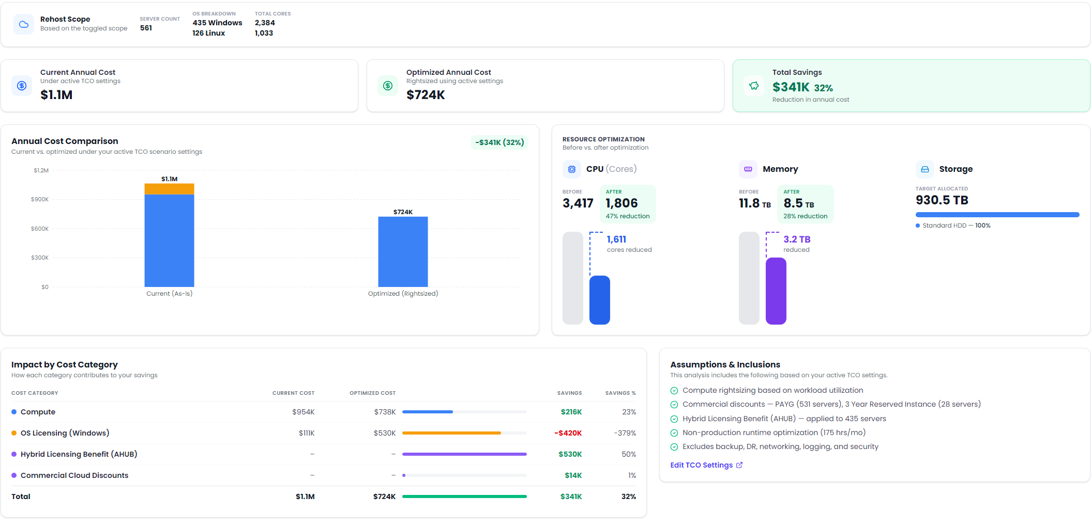
8F2CBFBB-FCD4-4B31-8021-968C2E867DE2
Estate Explorer
Infrastructure
Optimization
>
>
Server Optimization & Savings Opportunities
Identify over-provisioned compute and memory resources to reduce infrastructure costs while maintaining performance.
Notes:
- The headline here is not just cost reduction; it is evidence of systemic overprovisioning. That usually means the estate has grown through caution rather than engineering discipline, with capacity sized for peaks that rarely occur. For leadership, this is a maturity signal: there is meaningful room to improve financial efficiency without degrading service if optimization is governed properly.
- The largest opportunity sits in compute and memory, which tells us the first migration decision should not be “move as-is.” If workloads are lifted unchanged, you risk carrying today’s inefficiency into Azure and locking it into reserved commitments. Rightsizing before or during migration materially improves the business case and lowers the run-rate from day one.
- The licensing mix matters. The savings are being shaped as much by Windows licensing and Hybrid Benefit assumptions as by infrastructure tuning. That means planning confidence depends on license entitlement validation, Software Assurance status, and which servers are truly good candidates for reservation. Those are executive decisions because they directly affect ROI credibility.
- Storage appears comparatively fixed, which suggests optimization is less about footprint reduction and more about tiering, resilience choices, backup design, and data lifecycle management. That should steer attention toward governance and architecture rather than expecting storage alone to fund the program.
- There is also an important caution: several cost elements are excluded. Networking, security, backup, and DR can materially change the target operating cost. Before committing to business case numbers, the team should deepen discovery on dependency mapping, criticality, performance profiles, and operational requirements.
The following has been generated by AI. Consider checking important facts.

Slide 16

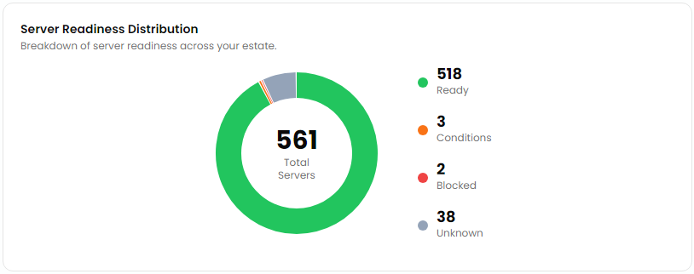
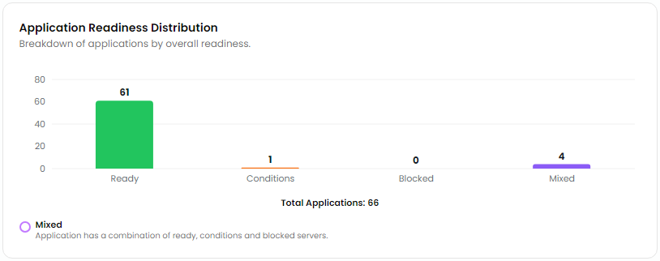
C616BDBB-E364-404F-B1EB-DC65DA5907E1
Estate Explorer
Modernization
Cloud Readiness
>
>
Migration Readiness
Assess server compatibility for rehost migrations and identify workloads that can be migrated with minimal remediation.
Server Readiness by Status
Readiness by Application
Server readiness distribution across your environment, highlighting systems ready for migration and those requiring remediation before deployment.
Application migration readiness based on the readiness of associated servers, helping prioritize low-risk migration candidates.
Ready to Migrate
Servers classified as Ready can typically be migrated using rehost with minimal or no remediation.
Application Readiness
Improve workload mapping within Dr Migrate for a more accurate view of 'Readiness by Application'. As servers are associated to applications this view will automatically update.
Notes:
- The headline here is that the estate appears largely suitable for a first-wave rehost migration. That matters because it reduces transition risk and creates an opportunity to move quickly on infrastructure exit, data center reduction, or hardware refresh avoidance without waiting for broad application redesign.
- The more important executive insight is not the small number of known blockers; it is the gap in certainty. Unknown readiness is a planning risk because it can distort timeline, budget, and dependency assumptions. Before committing to a migration factory model, I would tighten discovery on those unknown assets and validate whether they are low-value leftovers or business-critical exceptions.
- At the application level, readiness is slightly less clean than server readiness, which is typical. It tells us infrastructure may be movable, but application dependency mapping is still maturing. That has implications for cutover planning, outage risk, and sequencing. If you migrate servers without confirming app groupings, you can create operational instability even when individual machines are technically compatible.
- This points to a sensible strategy: start with a low-risk migration wave focused on clearly understood, ready workloads, while running a parallel remediation and dependency-validation track for mixed and conditional applications.
- The transformation opportunity is to use rehost as an entry point, not the end state. Once workloads are stabilized in Azure, you can prioritize modernization based on business value, supportability, security exposure, and cost profile rather than trying to modernize everything upfront.
- Executives should now decide how much uncertainty they are willing to accept in wave one, and whether the objective is speed, optimization, or platform standardization. That decision will drive the level of discovery, governance, and landing zone controls needed before execution.
The following has been generated by AI. Consider checking important facts.

Slide 17

A863C0C5-B789-47D4-BB54-56C9695B70F0
Modernization Opportunities
Identify opportunities to optimize cost and efficiency through right-sizing and licensing adjustments
Notes:
- This is really about using modernization to improve the economics of the estate before, during, and after migration. If we move inefficiently sized workloads or preserve legacy licensing patterns in the cloud, we simply relocate cost and complexity instead of reducing them.
- Right-sizing is also a maturity signal. When an organization has limited visibility into actual utilization, it typically means governance, performance baselining, and application ownership are not yet consistent. That creates planning risk because migration waves may be built on assumptions rather than observed demand.
- Licensing is often one of the fastest levers for business value, but it needs to be handled deliberately. Decisions around hybrid use rights, SQL and Windows entitlements, and support timelines can materially change the cloud business case. Done well, this improves ROI; done poorly, it locks in avoidable spend for years.
- The bigger opportunity is to separate “move” from “modernize.” Some assets should be right-sized and rehosted quickly; others may justify refactoring, platform services, or retirement. Executives should expect a portfolio approach, not a single migration pattern.
- This also has operational implications. Standardized sizing, tagging, and policy enforcement in Azure make cost control sustainable. Without those controls, savings identified in assessment are usually eroded by post-migration sprawl.
- The next decision is where deeper discovery will improve confidence: application dependencies, usage patterns, and license position. That is what turns a technical inventory into an investable modernization roadmap.
The following has been generated by AI. Consider checking important facts.

Slide 18
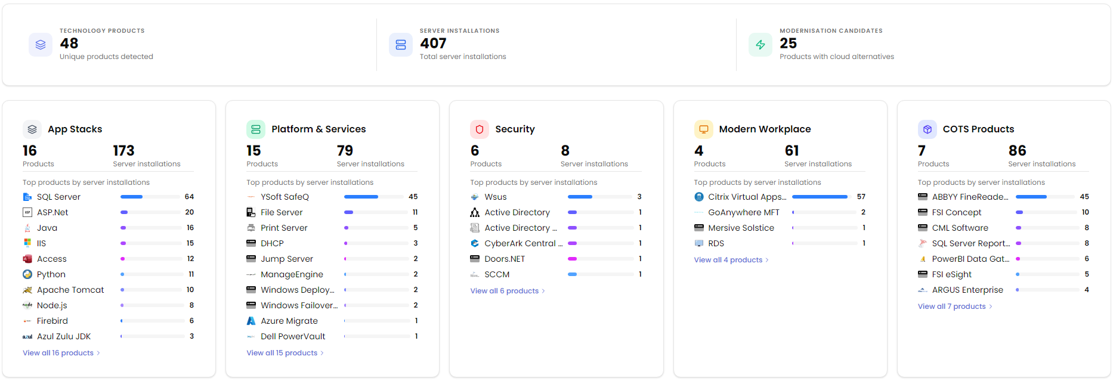
EE6F1390-4334-46F8-B970-C781D6EA6A5D
Estate Explorer
Technologies
>
Technology Domains Analyzed
Technologies discovered across your environment have been grouped into logical domains to simplify analysis, identify trends, and prioritize modernization opportunities. These domains form the foundation for the modernization and risk insights presented throughout this report.
Notes:
- The important takeaway is concentration. A relatively small set of technologies appears repeatedly across the estate, which usually means there is meaningful standardization beneath the surface. That is good news for migration planning because repeatable patterns can be engineered once and scaled, lowering effort, risk, and time to value.
- At the same time, there is still enough product diversity to signal architectural sprawl. That typically drives higher support costs, fragmented skills, inconsistent patching, and uneven governance. Executives should view this as both a risk and a rationalization opportunity: reduce duplicate capability before moving everything as-is into cloud.
- The application layer is clearly dependent on a few core runtime and database technologies. That matters because modernization can be targeted where the estate is most concentrated, rather than treating every workload as unique. For Azure planning, this points toward a factory approach: assess common landing patterns for .NET, Java, SQL, and web tiers, then decide which should be rehosted first versus refactored.
- The platform and infrastructure services footprint suggests a meaningful amount of operational dependency on traditional server-based functions. Those dependencies often become hidden blockers in migration waves if identity, file services, printing, and network services are not sequenced early.
- Security components appear limited in breadth, which may indicate either tool consolidation or gaps in discovery. That should prompt validation of control coverage, especially around patching, identity hardening, and endpoint/server management before major migration activity.
- The clearest executive decision now is sequencing: prioritize high-volume, low-complexity patterns first, while launching a parallel effort to validate unsupported products, licensing constraints, and business-critical COTS dependencies.
The following has been generated by AI. Consider checking important facts.

Slide 19
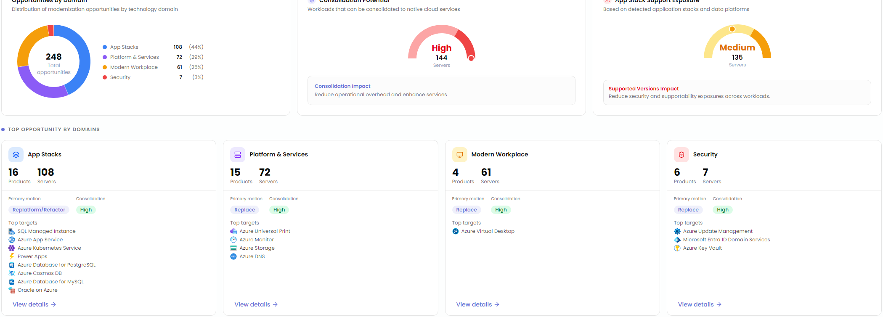
147486E1-4BAB-44A8-A6D4-EFAB6D787420
Estate Explorer
Modernization
>
Modernization Opportunities Snapshot
An executive overview of the highest-impact modernization opportunities across your estate, helping prioritize cloud adoption, technology consolidation, and operational improvements.
Notes:
- The dominant story here is that modernization value sits in the application and platform layers, not just infrastructure migration. That matters because a lift-and-shift strategy alone would leave much of the operational complexity, technical debt, and support risk in place. Executives should view this as a portfolio rationalization conversation, not a hosting decision.
- The concentration of consolidation opportunities suggests duplicated capabilities and fragmented service patterns across the estate. That typically drives avoidable cost, inconsistent resiliency, and higher support overhead. Standardizing onto shared cloud-native platform services can reduce that drag, but it requires strong architecture guardrails and clear ownership to avoid recreating the same sprawl in Azure.
- The application stack support exposure is strategically important. Unsupported or aging runtimes increase cyber risk, audit pressure, and change failure rates. This should influence sequencing: workloads with supportability issues often deserve earlier intervention, even if they are not the easiest to migrate.
- There is a meaningful split between “replace” and “replatform/refactor.” That tells us this is not a one-size-fits-all program. Some assets are better retired or substituted with managed services, while others justify deeper engineering investment. The decision point should be business criticality and future differentiation, not technical preference.
- Security appears smaller in count but high in leverage. Capabilities like secrets management, update orchestration, and identity modernization disproportionately improve governance and reduce operational risk across many workloads.
- Next, validate application dependencies, licensing constraints, and business ownership. That extra discovery will materially improve confidence in wave planning, savings estimates, and modernization ROI.
The following has been generated by AI. Consider checking important facts.

Slide 20

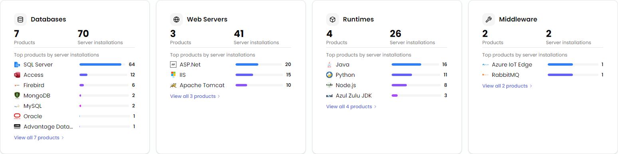
54DF9FBB-B6CD-411A-B349-DBD0D645E800
Estate Explorer
Technologies
>
Application Stack Landscape
Discover the runtime, database, web server, and middleware technologies that make up your application estate.
Notes:
- The main takeaway is estate sprawl without corresponding architectural standardization. There are enough overlapping platforms here to increase support overhead, patching complexity, licensing exposure, and recovery risk. That usually signals organic growth rather than deliberate platform governance.
- The concentration in a few dominant technologies is actually helpful. It means a large portion of the estate can likely be addressed through a small number of migration patterns rather than treating every application as unique. That improves planning confidence, shortens wave design, and creates a realistic path to factory-style modernization.
- The database mix matters more than the raw count. A strong dependence on one primary relational platform suggests good potential for landing-zone standardization, but the long tail of niche engines introduces migration friction, specialized skills dependency, and hidden business-critical applications that are often poorly documented.
- Multiple web, runtime, and middleware stacks indicate inconsistent application hosting decisions over time. That creates operational maturity issues: fragmented monitoring, uneven security baselines, and different upgrade cycles. Before migration, executives should decide where standardization is mandatory versus where business value justifies exceptions.
- The consolidation opportunity is significant because it directly affects cost and resilience. Rationalizing onto fewer managed patterns in Azure can reduce infrastructure ownership, improve patch compliance, and simplify DR, but only if application owners validate compatibility and support constraints early.
- Next, I’d push for deeper dependency mapping and lifecycle validation. The key executive question is not “what can move,” but “which platforms should we stop perpetuating as part of the future-state operating model.”
The following has been generated by AI. Consider checking important facts.

Slide 21

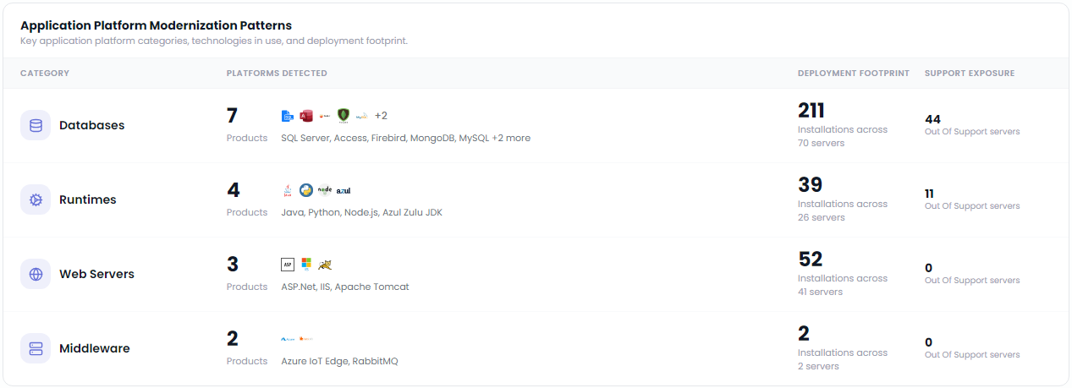
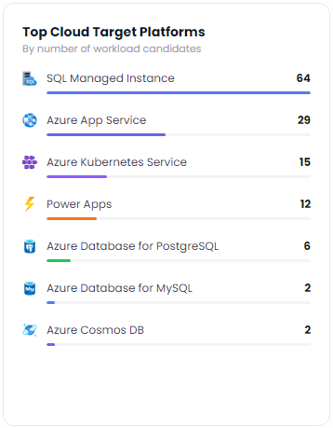
DE2239AE-1D48-4623-A24F-DCA9AD8EEB27
Estate Explorer
Technologies
Application Stack
>
>
Application Stack Modernization Opportunities
Recommended
Cloud Services
Discover the application platforms running across your environment and identify cloud-native modernization opportunities to reduce complexity, improve supportability, and simplify operations.
Based on the detected application platforms and modernization candidates
Notes:
- The main takeaway is platform sprawl. There are multiple database engines, runtimes, and web frameworks in use, which usually means support models, patching practices, and operational skills have grown organically rather than by design. That increases delivery friction and makes modernization more expensive unless the estate is first rationalized into a smaller set of strategic patterns.
- The biggest executive risk sits in the data tier. A large footprint combined with meaningful out-of-support exposure suggests technical debt is concentrated where business-critical systems are hardest to change. That has direct implications for security, audit posture, resilience, and upgrade cost. Database modernization should be treated as a business continuity and risk reduction program, not just an infrastructure refresh.
- The recommended landing zones indicate a practical path: managed database services for stability and supportability, app platform services for conventional web workloads, and containers only where there is a real portability or scale requirement. That matters because not every app needs the same target state, and forcing Kubernetes too broadly would add cost and operational complexity.
- This environment appears to have a sizable set of applications that could move with limited code change, which is good news for early momentum. The opportunity is to separate quick wins from applications that need deeper refactoring, and use those early migrations to fund more complex modernization later.
- Before locking in migration waves, I would validate application-to-database dependencies, lifecycle ownership, and business criticality. That additional discovery will materially improve confidence in sequencing, outage planning, and whether some platforms should be retired rather than migrated.
The following has been generated by AI. Consider checking important facts.

Slide 22

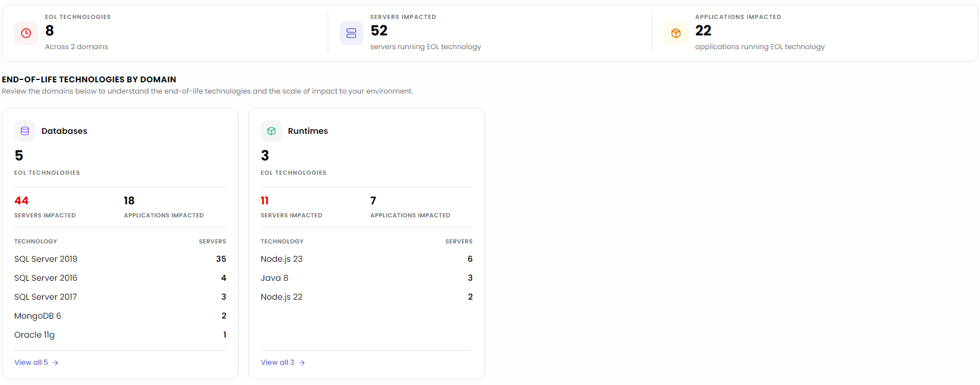
5BBAEDC4-7669-4314-9F51-402399B70A34
Estate Explorer
Technologies
Application Stack
>
>
Application Stack End-of-Life Technology Risk Overview
The following technologies have reached, or are approaching, end of vendor support. Review the affected application stacks to identify security, compliance and modernization priorities.
Notes:
- The important message here is concentration of risk, not just count. Most exposure sits in the data tier, which means this is not a simple patching issue. When unsupported database platforms underpin multiple applications, the blast radius includes security, compliance, resilience, and business continuity.
- This also signals a maturity gap in lifecycle governance. End-of-support technologies do not accumulate overnight; they usually indicate weak version management, unclear application ownership, or upgrades that have repeatedly been deferred because dependencies are poorly understood.
- The database-heavy profile changes migration planning. These workloads need dependency mapping, testing discipline, and rollback planning before any move. Treating them as straightforward infrastructure relocation would likely carry technical debt into Azure and preserve the same operational risk at a higher cost.
- The runtime findings matter because they often expose hidden modernization blockers. Older Java and Node versions typically point to fragile codebases, unsupported libraries, and pipelines that are not yet ready for continuous delivery. That affects both security posture and speed of change.
- Executives should think in two lanes: immediate risk reduction for unsupported platforms, and a parallel modernization roadmap for the applications tied to them. Azure can help by separating “upgrade in place” options from refactor paths, especially for SQL estates and application hosting.
- Before committing budgets, validate business criticality, vendor constraints, and upgrade compatibility. That extra discovery will materially improve sequencing, outage planning, and cost confidence.
The following has been generated by AI. Consider checking important facts.

Slide 23

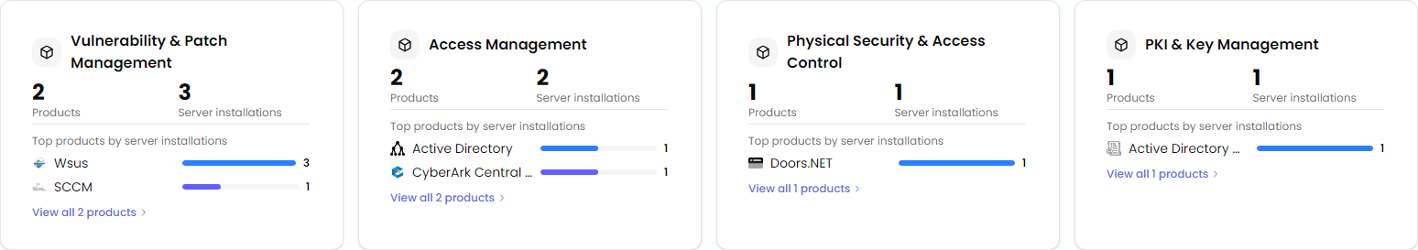
05D75CDF-46B4-4071-BA88-5E6F93CDB4E5
Estate Explorer
Technologies
Security
>
>
Security Landscape
Discover the security products protecting your environment, grouped by capability to identify coverage, duplication, and consolidation opportunities.
Notes:
- The main takeaway is not the number of tools; it is the fragmentation. Security capability is being delivered through overlapping point solutions, which usually means inconsistent policy enforcement, duplicated cost, and more operational handoffs during incidents. That increases risk even when coverage appears reasonable on paper.
- The strongest signal here is around consolidation. When multiple products are performing similar functions in a small estate, complexity becomes the real exposure. Different consoles, agent models, and reporting paths make it harder to prove control effectiveness and harder to execute a clean migration without carrying technical debt forward.
- Identity is also doing double duty across access control and key management. That suggests core trust services are tightly coupled to legacy directory infrastructure. For modernization, that matters because identity should be treated as a strategic control plane, not just an inherited dependency. This will influence sequencing for hybrid, zero trust, and privileged access changes.
- Patch and vulnerability management appears split across traditional tooling. That is a warning sign for cloud adoption because inconsistent patch posture translates directly into migration risk, audit findings, and slower application onboarding. Before moving workloads, executives should ask whether security baselines can be enforced uniformly across on-premises and cloud-hosted assets.
- The opportunity is to simplify before scaling. Rationalizing tools, standardizing operating processes, and centralizing visibility will typically improve security outcomes faster than adding more products. Azure can support that through integrated policy, security posture management, and identity governance, but only after agreeing the target operating model.
- Additional discovery should focus on control effectiveness, ownership, and exceptions—not just product inventory. That will materially improve confidence in migration planning and cost optimization.
The following has been generated by AI. Consider checking important facts.

Slide 24

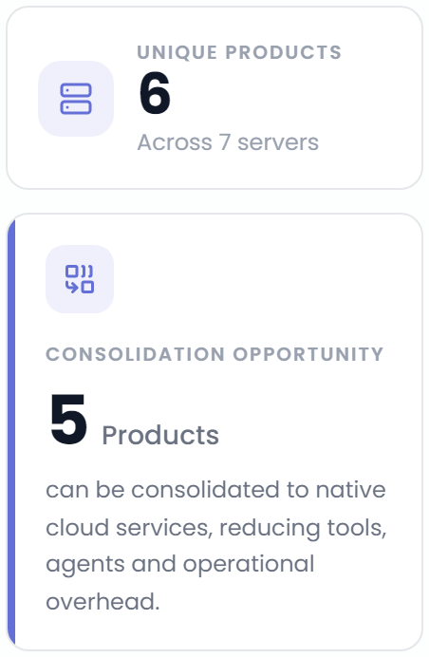
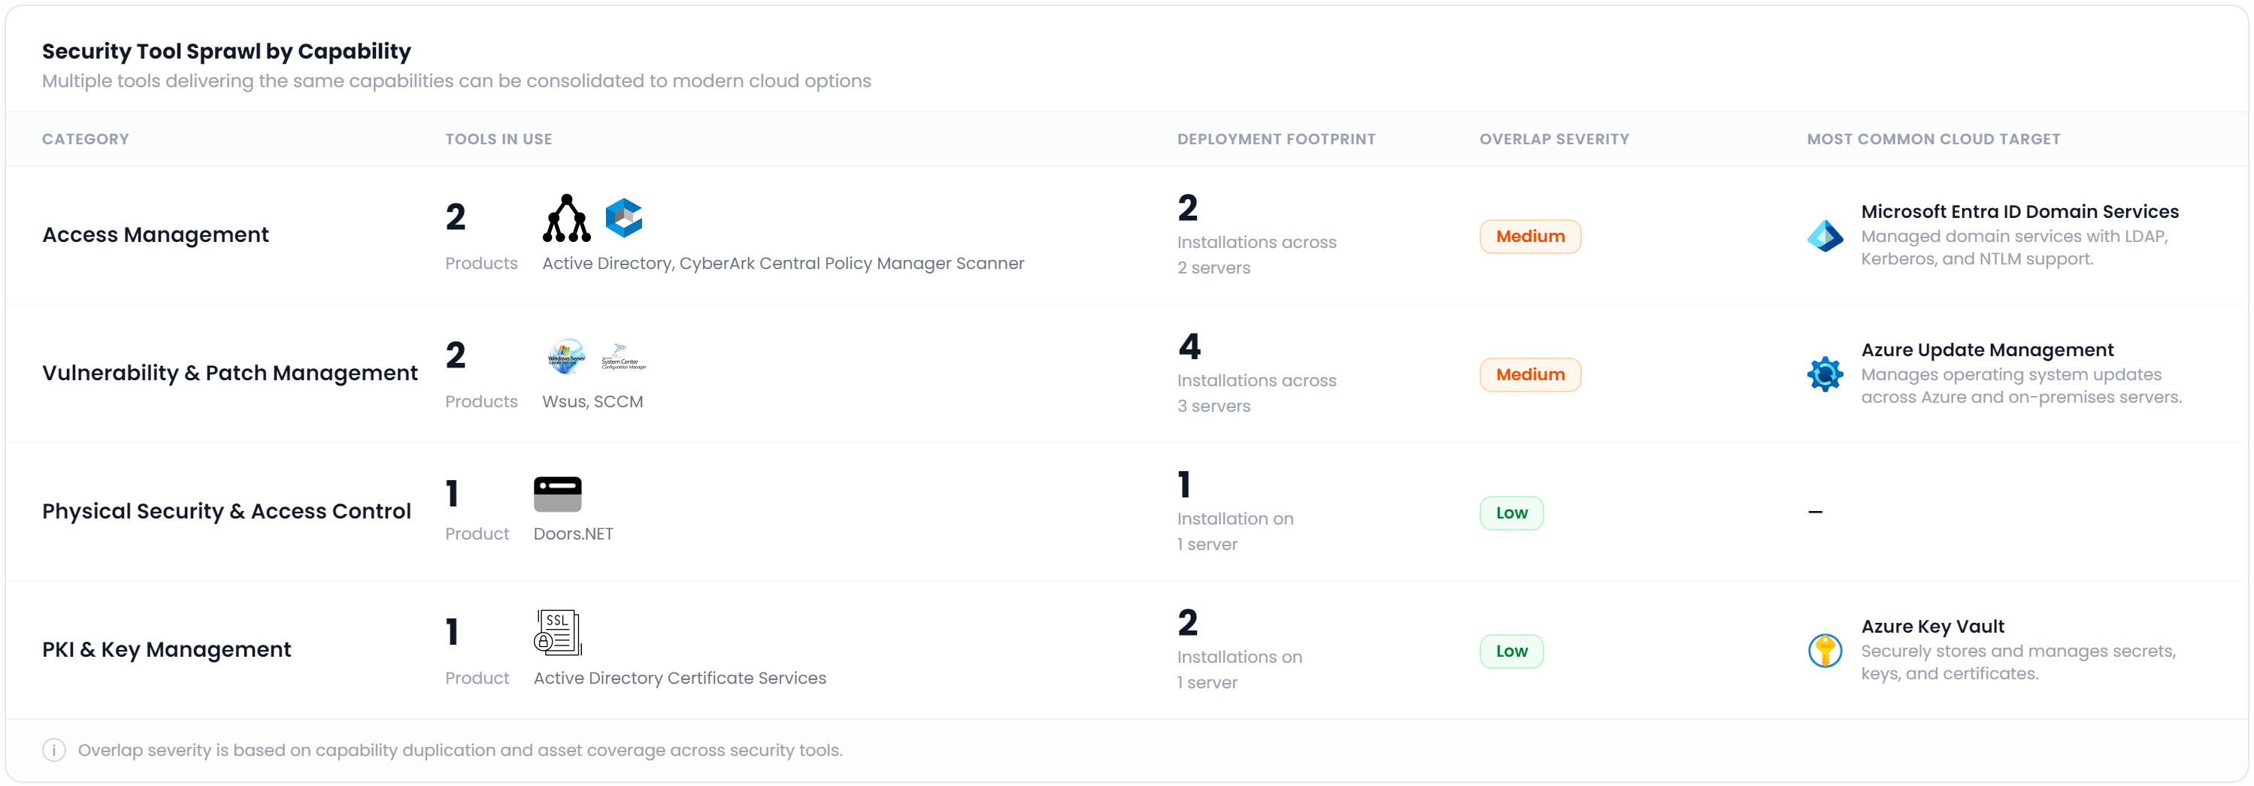
31F9EE39-E81E-4EC2-BFEC-B826010DE819
Estate Explorer
Technologies
Security
>
>
Security Modernization Opportunities
Security Tooling Consolidation
Identify overlapping security capabilities and consolidate onto modern cloud-native security platforms to simplify operations and reduce cost.
Notes:
- The bigger story here is not tool count; it is control fragmentation. When similar security functions are split across multiple products, teams create parallel processes for identity, patching, certificates, and privileged access. That increases policy drift, slows response, and makes it harder to prove consistent control effectiveness to auditors and regulators.
- The highest-value opportunity is in the overlapping operational domains, especially access and vulnerability management. Those are foundational controls. If they remain distributed, every migration wave inherits unnecessary complexity: multiple agents, competing workflows, duplicate data, and unclear ownership when incidents occur.
- This points to a mid-maturity environment: security capabilities exist, but they are not yet streamlined around a target operating model. That usually means the organization is paying twice—once in licensing or infrastructure, and again in admin effort, exception handling, and slower remediation cycles.
- For executives, this should influence migration sequencing. Consolidate core control planes early, before large-scale modernization. Moving workloads without rationalizing identity, patching, and key management often locks legacy tooling into the future-state architecture and reduces cloud operating benefits.
- There is also a governance implication: consolidation decisions should be made capability by capability, not product by product. The goal is standardization where it reduces risk, while preserving niche tools only where there is a clear technical or regulatory requirement.
- Next step: validate dependency depth, licensing commitments, and integration patterns. That discovery will determine whether consolidation can be done quickly as a cost and ops play, or needs to be phased as part of broader security transformation.
The following has been generated by AI. Consider checking important facts.

Slide 25

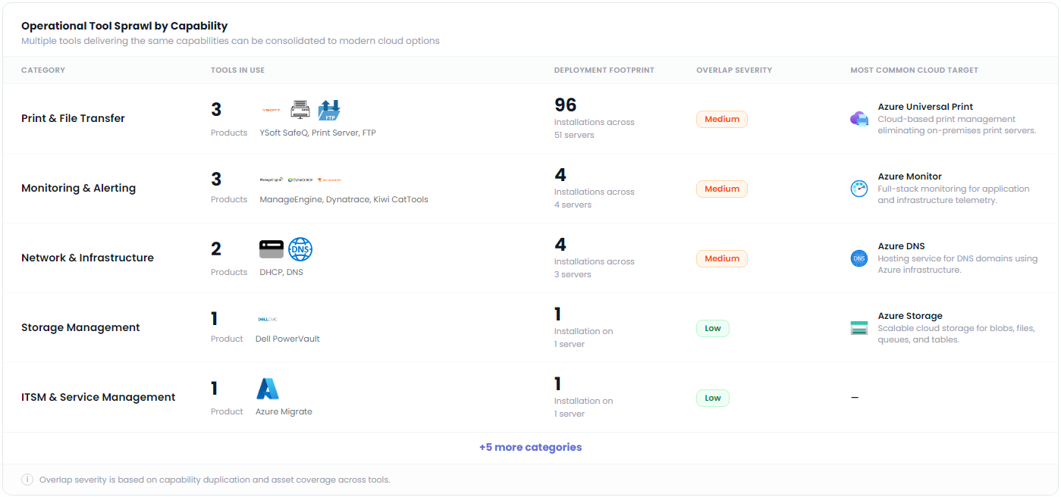
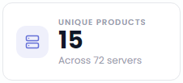
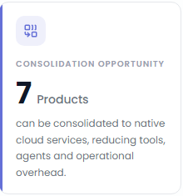
BDD30E2A-B773-48FD-99CA-047BB56B9F71
Estate Explorer
Technologies
Platform & Services
>
>
Platform Services Consolidation Opportunity
Platform & Services Modernization Insights
Notes:
- The big takeaway is not just tool count; it is duplicated operational capability. When multiple products perform the same function, you create inconsistent processes, fragmented telemetry, overlapping licensing, and more points of failure. That is usually a sign of organic growth rather than intentional platform design.
- The highest-value opportunity is in foundational services that touch many servers, particularly print/file transfer and monitoring. Those are broad enough to affect support effort, security posture, and migration complexity. Consolidating them early can reduce agent sprawl, simplify administration, and remove dependencies that otherwise slow application moves.
- This also says something about maturity: the environment appears to have pockets of capability rather than a standardized operating model. That raises governance risk because policy enforcement, logging, patching, and incident response are harder when each tool has its own control plane and data model.
- From a migration planning perspective, consolidation should be sequenced, not done indiscriminately. Some tools can be retired through direct adoption of Azure-native services; others may need temporary coexistence to avoid disrupting business-critical workflows. The right decision is capability-by-capability, based on integration dependencies and operational readiness.
- Security and cost are closely linked here. Fewer tools means fewer service accounts, fewer privileged consoles, less unpatched infrastructure, and clearer ownership. It also creates better FinOps visibility because spend moves from hidden operational overhead into measurable platform services.
- Before committing, executives should ask for dependency mapping, usage validation, and support model assessment. That will materially improve confidence in which consolidations are low-risk quick wins versus those requiring broader operating model change.
The following has been generated by AI. Consider checking important facts.

Slide 26

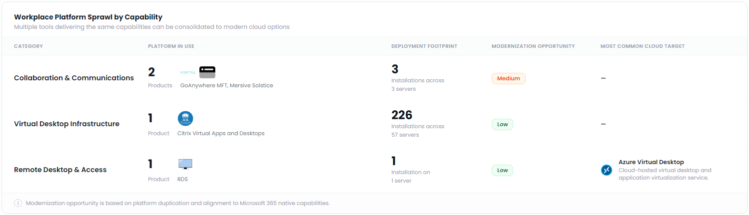

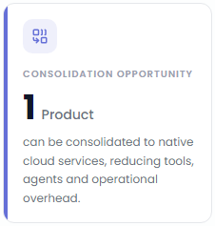
65CBD466-9CE3-4B08-914F-51345592748A
Estate Explorer
Technologies
Modern Workplace
>
>
Modern Workplace Modernization Insights
Modern Workplace
Consolidation Opportunity
Your workplace environment presents opportunities to consolidate remote access, collaboration, and endpoint management onto cloud services. This reduces platform sprawl while improving security, governance, and the employee experience.
Notes:
- The main message here is not scale; it is fragmentation. Even with a relatively small set of workplace tools, overlapping capability creates unnecessary operational drag. That typically means duplicated administration, inconsistent user experience, and policy gaps that become visible during audits, security incidents, or employee onboarding.
- The strongest executive takeaway is that remote access and collaboration should now be treated as control points, not just productivity services. When those capabilities are spread across legacy and niche platforms, identity, conditional access, device compliance, and session monitoring become harder to enforce consistently.
- The virtual desktop footprint suggests this area is operationally significant, even if the immediate modernization rating is conservative. At that scale, decisions around image management, application packaging, licensing, and user segmentation can materially affect both cost and support quality. This is where a deeper workload and persona analysis would improve planning confidence.
- The clearest near-term opportunity is consolidation of remote desktop access into a more standardized cloud-aligned model. That can reduce server dependency, simplify support, and improve resilience, but only if application compatibility and network latency are understood upfront.
- Strategically, this points to a broader workplace modernization conversation: standardize the endpoint and access stack, reduce tool exceptions, and align collaboration, device management, and remote access under a common governance model.
- Executives should view this as an operating model decision, not a tooling exercise. The value is lower complexity, stronger security posture, and a more predictable employee experience.
The following has been generated by AI. Consider checking important facts.

Slide 27
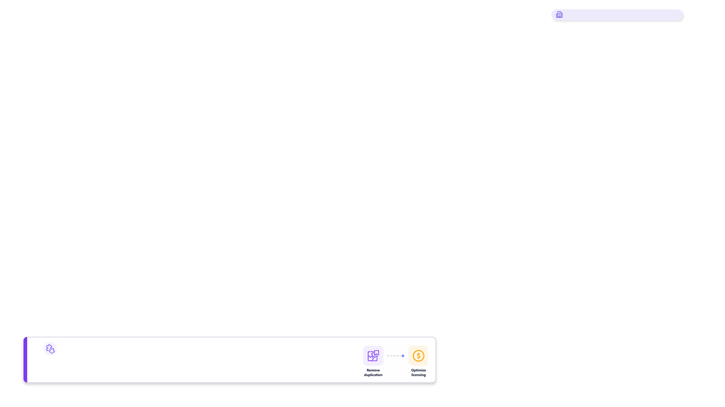
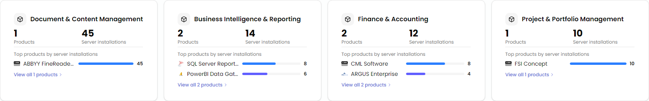
1A1CFE48-A2D0-44E7-AA56-F3E0A55119F2
Estate Explorer
Technologies
COTS
>
>
Commercial Software Portfolio
Understand the commercial software products discovered across your environment, where they are deployed, and opportunities to consolidate, modernize, or retire redundant technologies.
Identify consolidation opportunities
Review products by category to understand where multiple technologies deliver similar capabilities. Consolidating overlapping software can reduce licensing costs, simplify operations, and accelerate cloud adoption.
Notes:
- The important story here is not product count; it is concentration. A small number of commercial platforms are spread broadly across the estate, which usually means they are business-critical and tightly embedded in operations. That raises the stakes for migration planning: these are not simple lift-and-shift candidates without dependency, licensing, and support validation.
- The consolidation signal is meaningful because overlapping tools in reporting and finance often reflect decentralized buying and inconsistent operating models. That creates avoidable cost, fragmented data, and duplicated skills. Rationalizing those areas can reduce run cost, but more importantly it simplifies governance and makes modernization efforts more achievable.
- The document management footprint deserves executive attention. When one platform is deeply distributed, it often becomes a proxy for records management, workflow, and compliance obligations. If that product is aging or heavily customized, it can become a blocker to cloud adoption and a source of regulatory risk unless content architecture and retention requirements are addressed early.
- The presence of specialized finance and project tools suggests some workloads may be commercially sensitive or operationally unique. Those should be treated as business capability decisions, not just infrastructure decisions. The key question is whether to retain, replace, or surround them with modern integration and data services.
- From a maturity perspective, this looks like an environment ready for portfolio rationalization, but not yet for aggressive standardization without deeper discovery. Executives should ask for application dependency mapping, contract and renewal timing, and product ownership clarity before locking migration waves.
The following has been generated by AI. Consider checking important facts.

Slide 28

621D2BE4-0015-4218-94C1-3E33CC62F2D3
Cloud and SaaS Services
Identify opportunities cloud hosting services assessed and initial opportunities

Slide 29

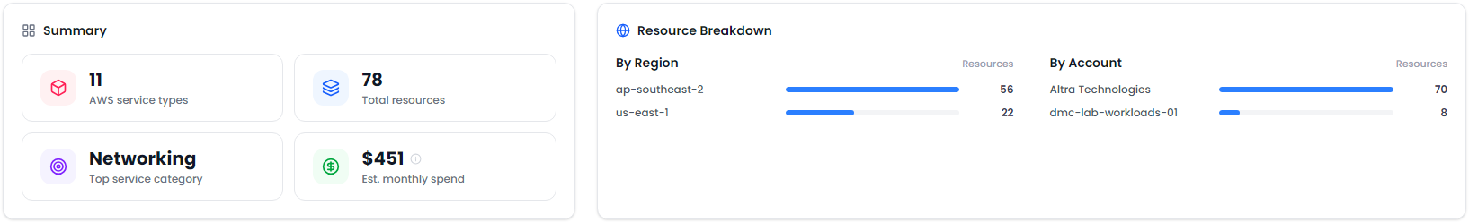
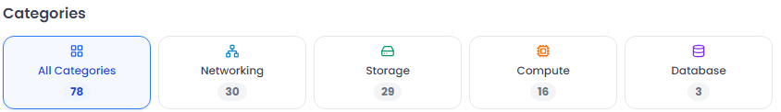
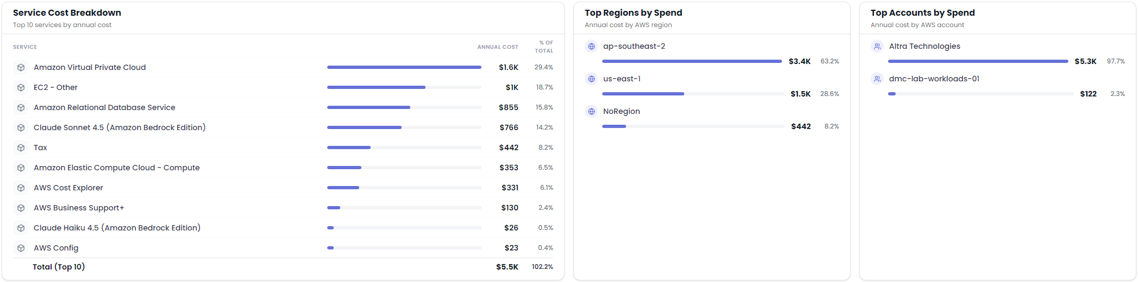
233D2CB4-F4C1-4291-A4F8-18B76E7DD561
Estate Explorer
Infrastructure
AWS
>
>
AWS Services and Cost Overview
AWS Service Inventory
Review the services discovered across connected AWS accounts, including resource inventory, service categories, regional distribution, and estimated cloud expenditure.
Gain a clear view of your AWS landscape, including discovered services, resources distribution and estimated spend across your environment.
Notes:
- The important story here is not the absolute spend; it is the shape of the estate. This environment is network-heavy, lightly distributed across accounts, and concentrated in a small number of regions. That usually indicates an early-cloud or minimally governed footprint rather than a scaled multi-account operating model.
- The cost mix suggests foundational services are carrying a meaningful share of spend. When networking and shared platform components dominate, executives should ask whether the architecture was intentionally designed for resilience and segmentation, or whether complexity accumulated without clear business value. That distinction matters before any migration or modernization plan is funded.
- The concentration of resources and spend in one primary account creates operational and governance risk. It can slow delegation, blur ownership, and make cost accountability difficult. If this estate grows, the lack of stronger account segmentation, policy enforcement, and landing zone discipline will become a control issue, not just a technical one.
- There is also a regional concentration pattern. That may simplify operations today, but it raises questions around resilience, data residency, and recovery assumptions. Additional discovery on business continuity requirements would materially improve planning confidence.
- The opportunity is to treat this as a right-sizing and governance moment: rationalize network design, validate whether managed database and compute choices are aligned to application criticality, and establish clearer tagging, policy, and cost allocation. If Azure becomes part of the target state, this informs landing zone design, migration waves, and where platform standardization could reduce both risk and operational drag.
The following has been generated by AI. Consider checking important facts.

Slide 30

CFBFE402-885A-480F-9677-02A61DE5C910
Next Steps
Turn assessment findings into a clear, prioritized migration and modernization plan.

Slide 31
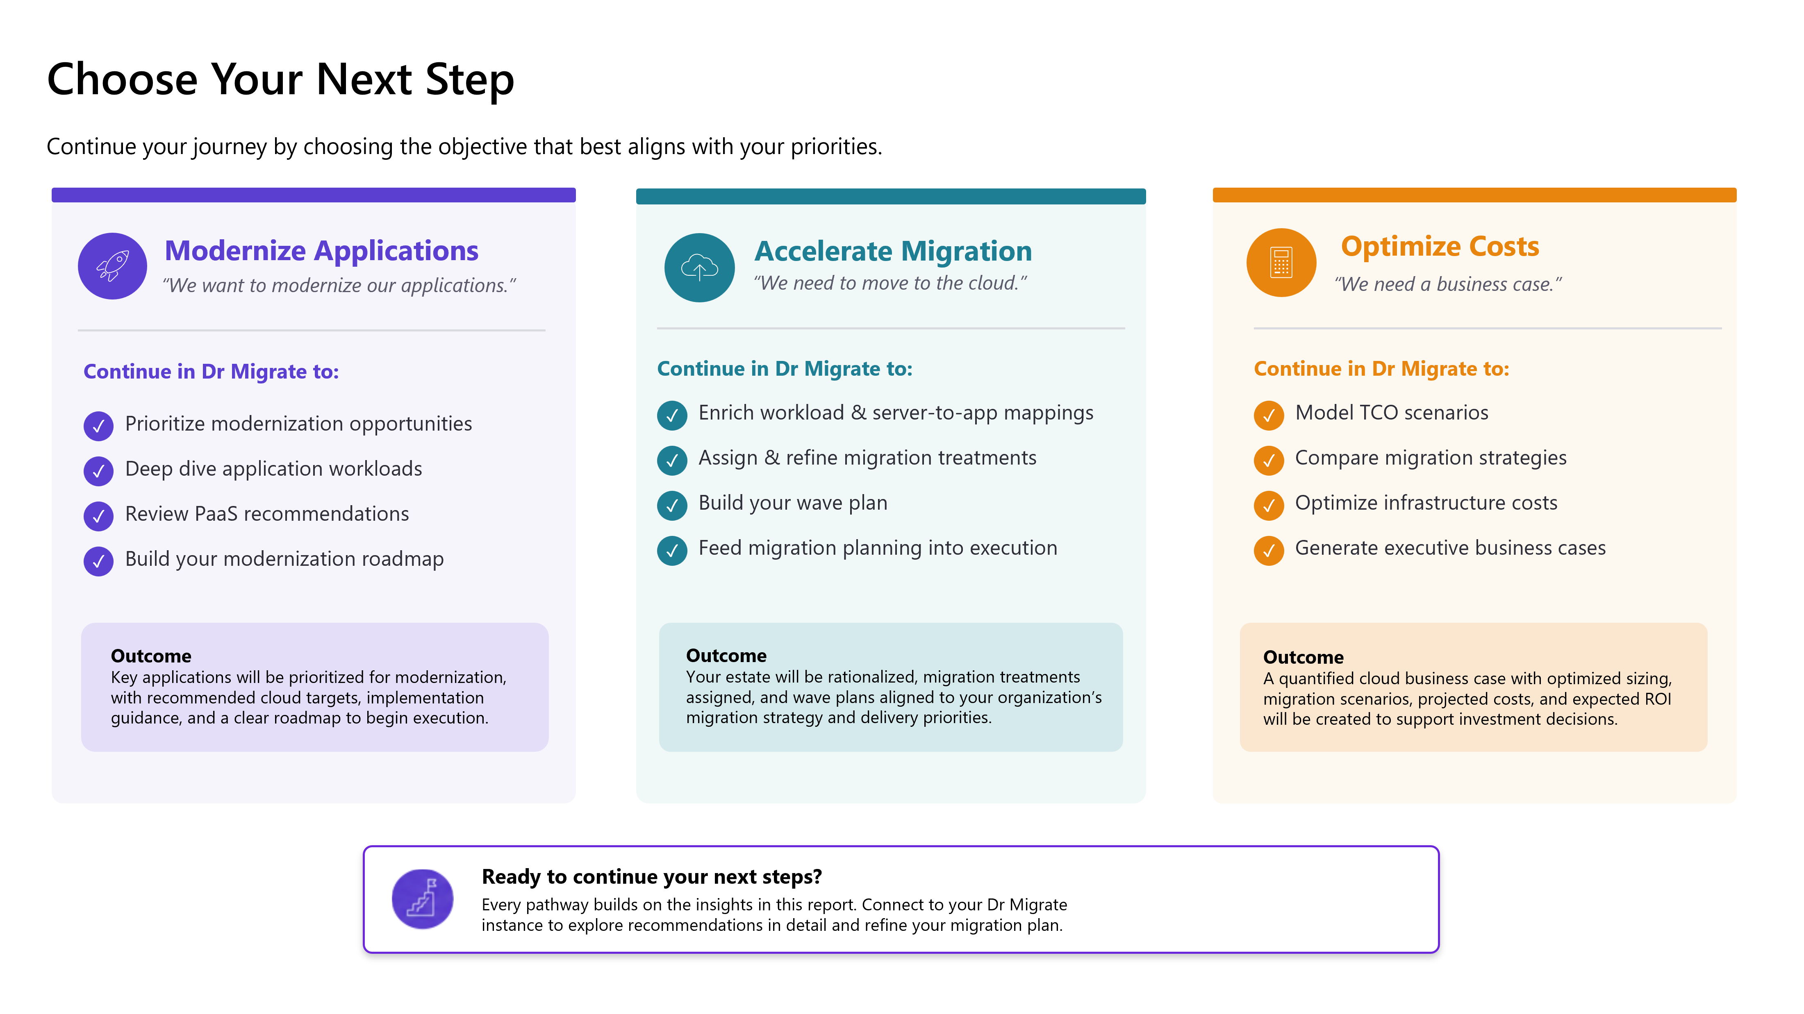
42A10DAF-C45B-4C79-8A3B-C305D6D9F578

Slide 32
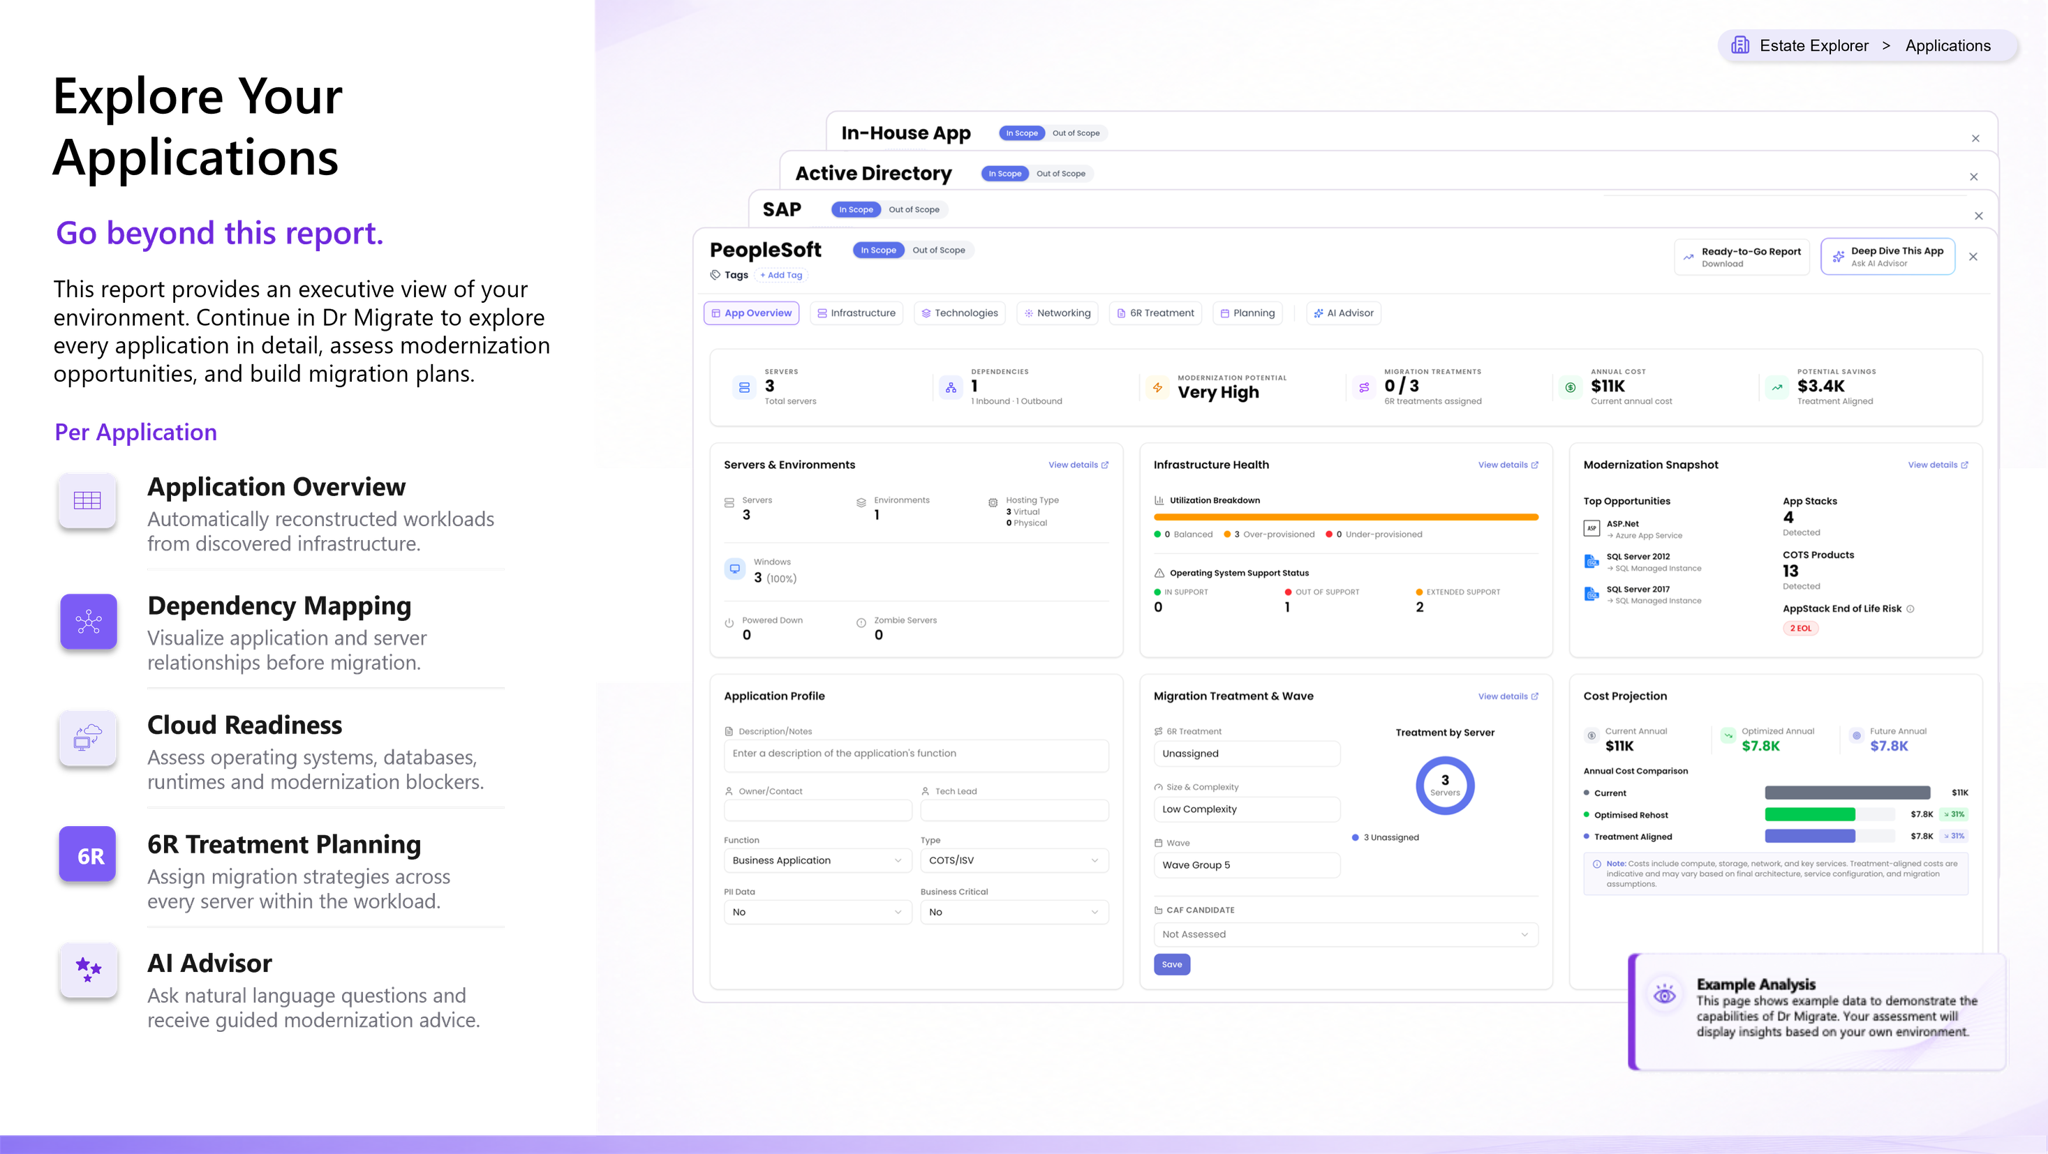
FF8E585C-6B9B-42A1-859B-1A655789B29B

Slide 33
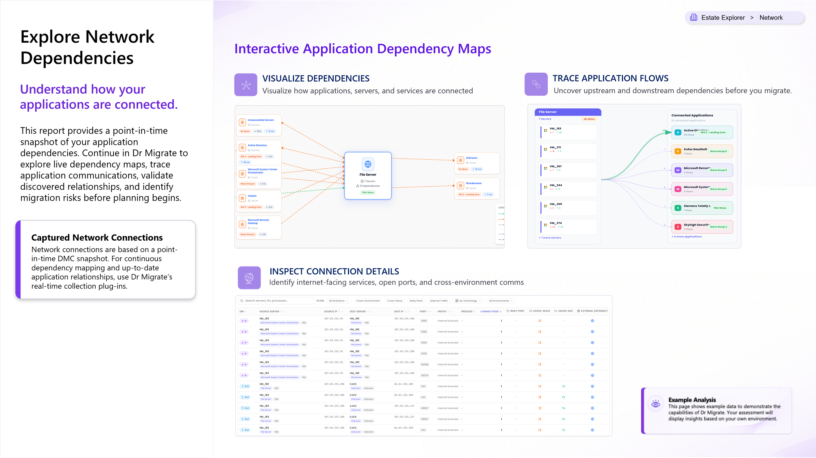
841B8B1D-EAF3-44B3-B260-8FBE11F5331F

Slide 34
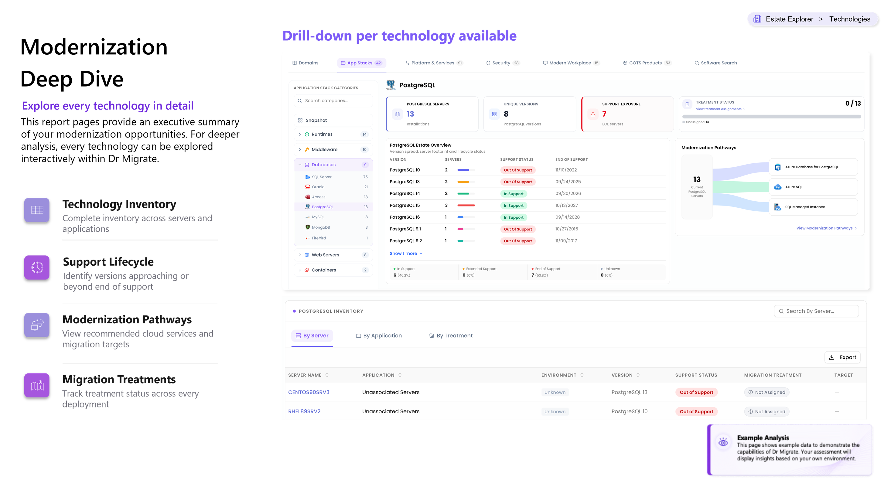
494A703C-E89A-4D66-AD03-7F0C1227CA9A

Slide 35
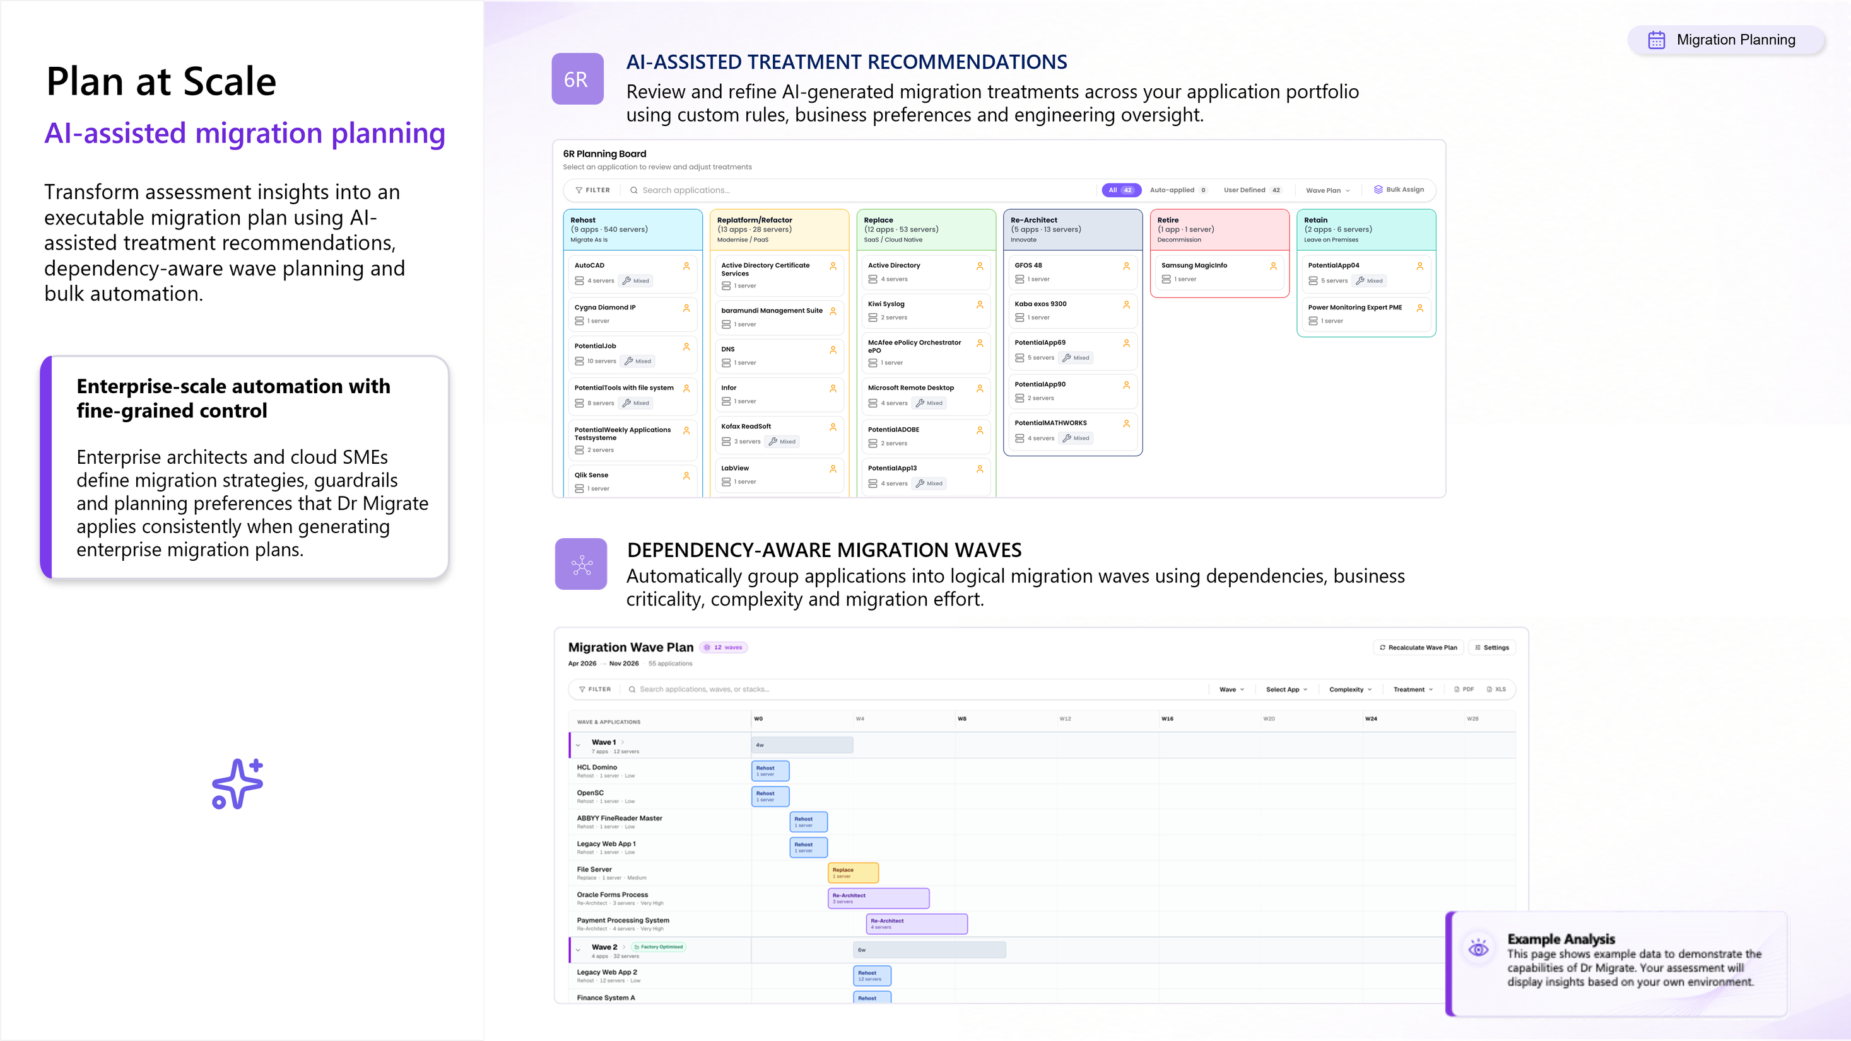
19DB3050-B3EB-4F42-B8A0-94DCC9934888

Slide 36
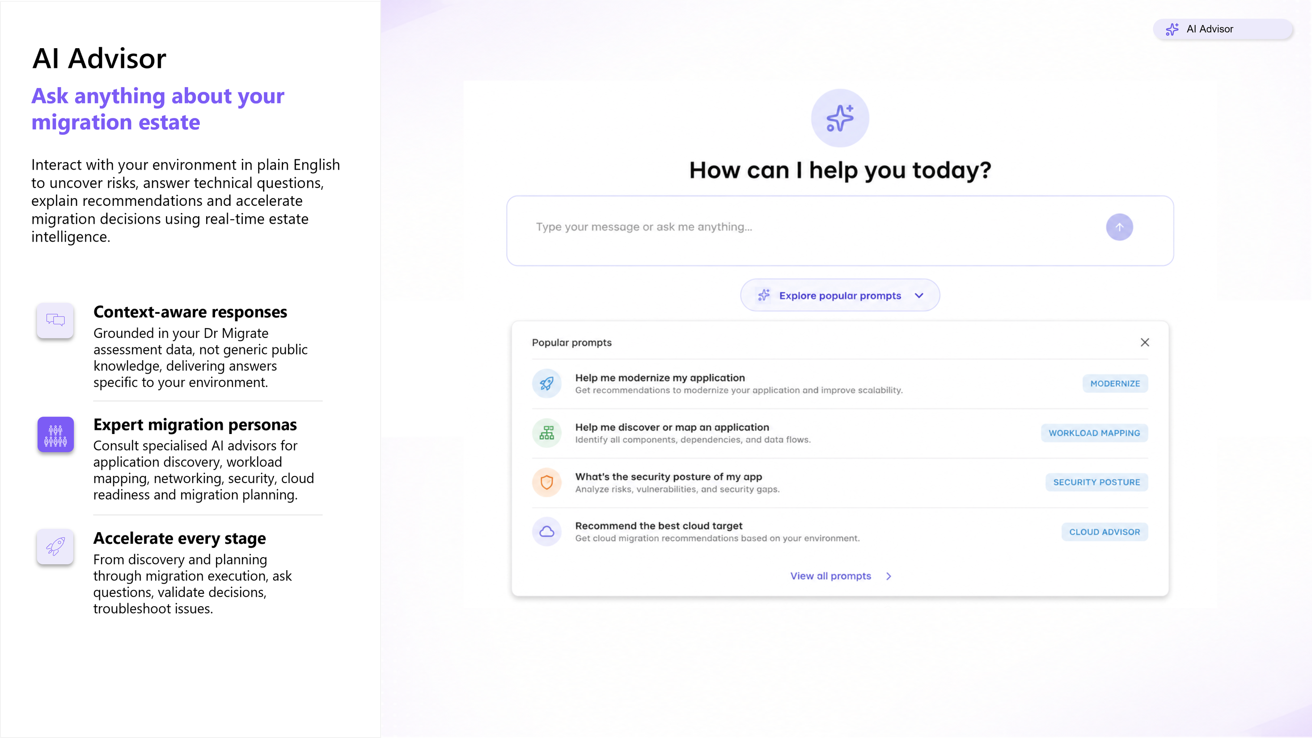
5E392876-AB57-4970-8DC4-0816ABD73E02

Slide 37

44CADFD9-3296-4D76-9D5B-46307B76E73D
Appendix
Additional insights.

Slide 38
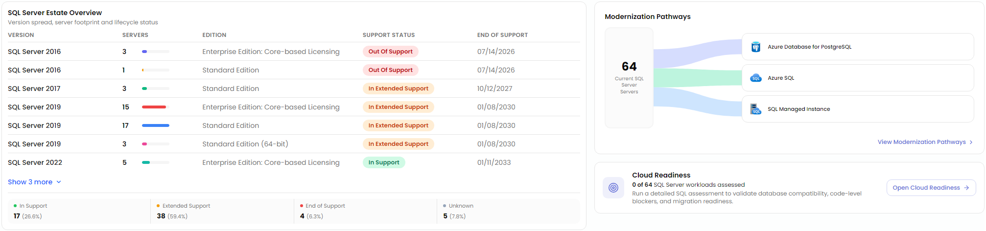
FAE69733-A2F9-4EC4-9F11-E4E4D548B234
Estate Explorer
Technologies
>
SQL Inventory
Supporting analysis of the SQL estate, including deployment footprint, version compliance, support status, and cloud modernization opportunities.
Note: Dr Migrate supports detailed cloud readiness assessment for SQL servers.
Notes:
- The main story here is lifecycle risk, not just database count. A meaningful portion of the estate is already out of support or living on extended support, which raises security, compliance, and resilience concerns. For executives, that means this is no longer simply a platform refresh discussion; it becomes a business risk reduction program.
- The environment also appears fragmented across multiple versions and editions. That usually signals inconsistent standards, uneven patching practices, and higher operational overhead. It makes forecasting support costs harder and slows modernization because each version path carries different remediation, testing, and licensing implications.
- The encouraging point is that treatment intent is already defined across the estate. That suggests the organization has enough visibility to move from assessment into sequencing. The next decision is not whether to modernize, but how to prioritize: business-critical workloads first, unsupported platforms second, and low-complexity wins early to build momentum.
- The modernization paths imply this is not a one-size-fits-all migration. Some workloads are candidates for managed SQL services, while others may be better aligned to platform alternatives. That opens an opportunity to reduce infrastructure management, improve backup and high availability posture, and standardize governance—but only if application dependencies are validated early.
- The biggest planning gap is cloud readiness depth. Without detailed SQL compatibility and code-level analysis, timelines and savings assumptions remain directional. Additional discovery will materially improve confidence in migration waves, remediation effort, and the balance between rehost, refactor, and replace.
The following has been generated by AI. Consider checking important facts.

Slide 39
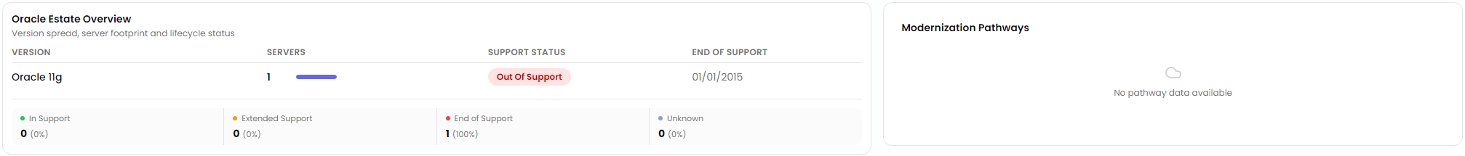
C70669E8-DC04-4F23-87F5-2071BE8D869B
Estate Explorer
Technologies
>
Oracle
Supporting analysis of the Oracle estate, including deployment footprint, version compliance, support status, and cloud modernization opportunities.
Notes:
- The immediate issue is not scale, it is exposure. Even a small Oracle footprint becomes a material risk when it is sitting on a version that has been out of support for years. That creates avoidable security, audit, and operational continuity concerns, especially if the platform underpins a business-critical workload.
- This also points to a maturity gap in lifecycle governance. A legacy database left in place this long usually means ownership, upgrade planning, and dependency management have not been actively managed. The technical problem is small; the governance signal is bigger.
- The encouraging part is that the estate appears narrow and concentrated. With only a limited Oracle dependency, this is the kind of issue that can often be resolved quickly through a focused decision: retain and upgrade, replatform, or retire. It should not become a multi-year program by default.
- The stated treatment direction toward replatform/refactor suggests an opportunity to reduce long-term vendor concentration and simplify operations. If the application dependency is modest, this may be a good candidate to move to a managed relational platform in Azure, reducing patching, backup, and availability overhead.
- The main planning risk is incomplete discovery. We need to confirm application coupling, data gravity, licensing position, performance requirements, and business criticality before locking in the target path.
- Executives should treat this as an early win: remove unsupported risk, prove modernization motion on a contained scope, and use it to establish stronger database lifecycle controls going forward.
The following has been generated by AI. Consider checking important facts.

Slide 40
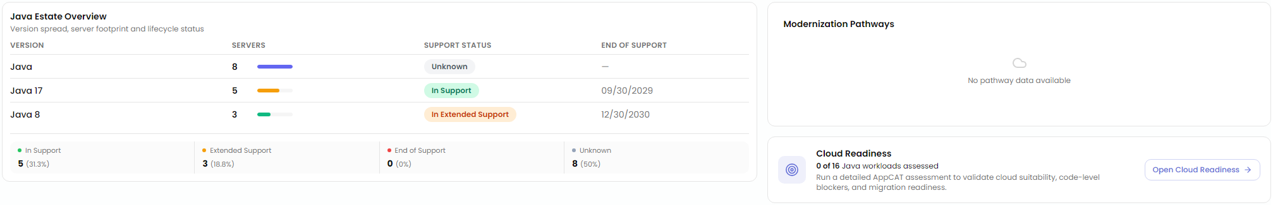
3B2DCA48-0F4E-46D9-B59D-3AFDE2DCA965
Estate Explorer
Technologies
>
Java Inventory
Supporting analysis of the Java estate, including deployment footprint, version compliance, support status, and cloud modernization opportunities.
Note: Dr Migrate supports detailed cloud readiness assessment for applications running Java.
Notes:
- The immediate message is not scale, it is uncertainty. A meaningful portion of the Java estate cannot be confidently placed in a support lifecycle, which weakens risk reporting, budgeting, and migration sequencing. Before making platform decisions, leadership should close that visibility gap because unknown support status often hides untracked technical debt and unplanned upgrade effort.
- The version spread is relatively contained, which is good news. With only a few Java versions in use, standardization is achievable and should be treated as a near-term modernization lever. Reducing version variance lowers testing complexity, simplifies security patching, and makes it much easier to define repeatable landing patterns for migration.
- The presence of workloads already in extended support is a strategic cost and resilience issue. Even if these systems are still running reliably, they are becoming more expensive to maintain and harder to secure over time. That should influence which applications are prioritized for remediation, especially those tied to regulated data or critical business processes.
- The absence of assessed modernization pathways means this is still an inventory, not yet a migration plan. Executives should avoid interpreting estate visibility as readiness. The next decision point is application-level discovery: dependency mapping, code compatibility, runtime requirements, and operational criticality.
- Treatment status suggests action has started, but the choices matter. Some workloads may justify rehost, others need upgrade, containerization, or retirement. Azure becomes relevant where it reduces lifecycle risk through managed runtime options, policy-driven governance, and better observability—but only after application suitability is validated.
The following has been generated by AI. Consider checking important facts.

